Slide 1
Computer Networks
Gu Qing, Xia Nai
Nanjing University
2011-9-13

Slide 2
Chapter 2. Direct Link Networks
Link Service and Framing
Error Detection and Reliable Transmission
HDLC, PPP, and SONET
Ethernet
Token Ring
Bridges and Layer-2 switch
Wireless Networks
Network Performance

Slide 3
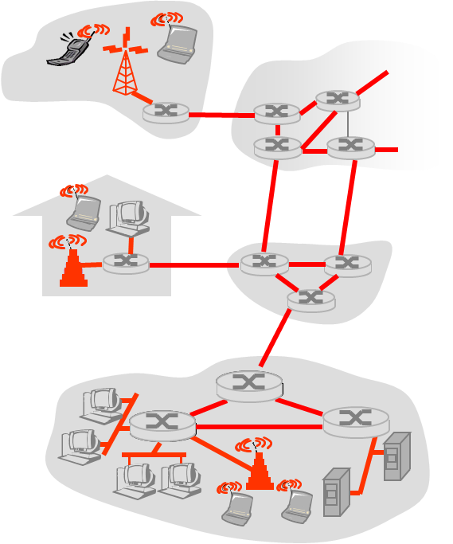
Link Service and Framing
Hosts and routers are nodes
Communication channels that connect adjacent nodes are links
Different types of links
Wired point-to-point links
Wired multiple access links (LANs)
Wireless links (WiFi)

Slide 4
Link Layer Services
Data-link layer has the responsibility of transferring data over the links
Framing
Encapsulate upper-level data into frame, adding header and trailer
Link access
Coordinate access for shared multiple access medium
“MAC” addresses used in frame headers to identify source and destination
Half-duplex and full-duplex
If transmit and receive at the same time

Slide 5
Link Layer Services
Reliable delivery over the link
Seldom used on low bit-error link (e.g. fiber)
Wireless links: high error rates
Flow control
Pacing between adjacent sending and receiving nodes
Error detection
Handling errors caused by signal attenuation or noise
Receiver detects presence of errors:
Signals sender for retransmission or drops frame

Slide 6
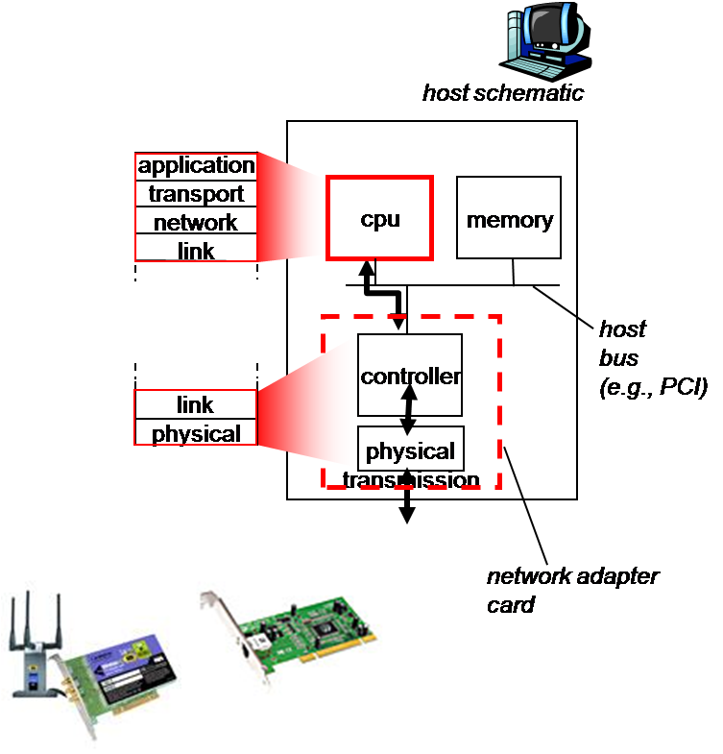
Implement the Link Layer
In host and router (switch)
Link layer implemented in “adaptor”
i.e. network interface card (NIC)
Ethernet card, 802.11 card
Implements link, physical layer
Attaches into host’s system buses
Combination of hardware, software, firmware
Notes:
Firmware: small programs and data structures that internally control electronic devices

Slide 7
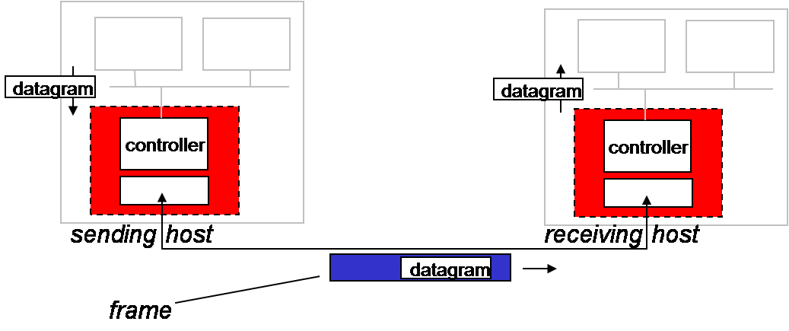
Link Layer Framing
Sending side
Encapsulates datagram in frame
Adds error checking bits, flow control, etc.
Receiving side
Looks for errors, flow control, etc.
Extracts datagram, passes to upper layer

Slide 8
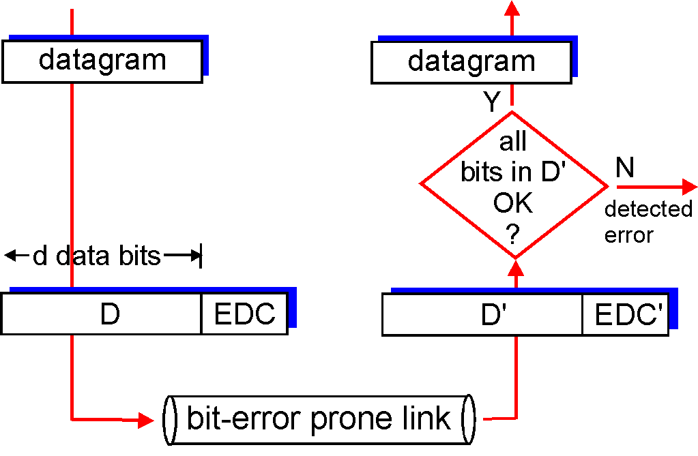
Error Detection and Reliable Transmission
EDC= Error Detection and Correction bits (redundancy)
D = Data protected by error checking, may include header fields
Note: error detection not 100% reliable!
Larger EDC field yields better detection and correction

Slide 9
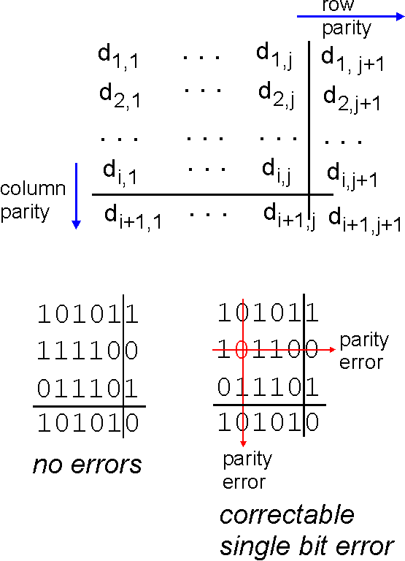
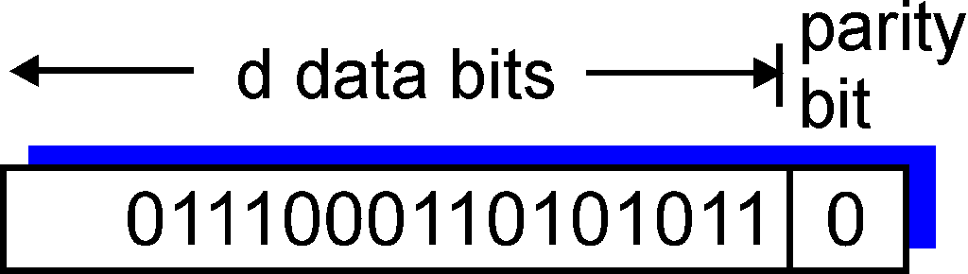
Parity Checking
Single Bit Parity:
Detect single bit errors
Two Dimensional Bit Parity:
Detect and correct single bit errors

Slide 10
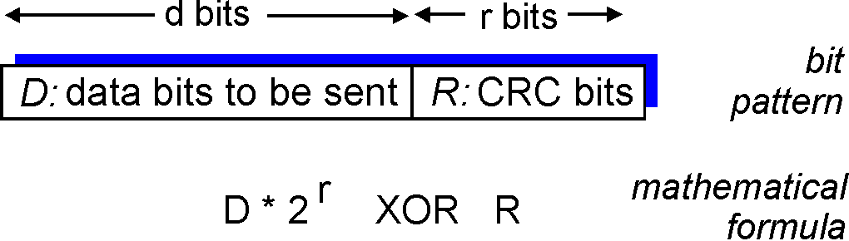
Cyclic Redundancy Check
Widely used in hardware-based implementation
View data bits, D, as a binary number
Choose r+1 bit pattern (generator or polynomial), G
Calculate r bit CRC bits, R, such that
<D, R> exactly divisible by G (modulo 2)
Receiver knows G, divides <D,R> by G, if non-zero remainder: error detected!
Can detect burst errors less than r+1 bits
Notes:
生成多项式

Slide 11
Flow Control
Ensuring the sender not overwhelm the receiver
Preventing buffer overflow
Methods
Stop and Wait
Sliding window

Slide 12
Stop and Wait
Source transmits frame
Destination receives frame and replies with ACK
Source waits for ACK before sending next frame
Destination can stop flow by not send ACK
Sequence no 0 and 1 to handle error
Work well for large frames

Slide 13
Sliding Window
Allow multiple frames to be in transit
Receiver has buffer (window) sized Win
Sender can send up to Win frames without ACK
Each frame is numbered
ACK includes number of next frame expected
Sequence number bounded by field of size (k)
Frames are numbered modulo 2^{k}
Question: how to set k given Win

Slide 14
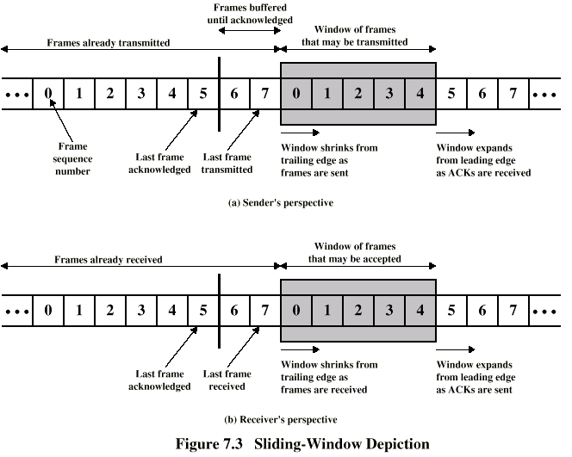
Illustration of Sliding Window

Slide 15
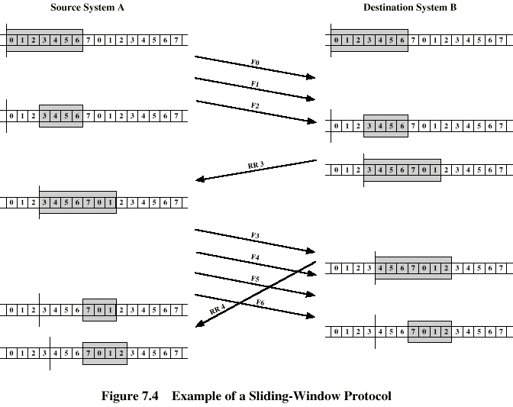
Illustration of Sliding Window

Slide 16
Error Handling in Sliding Window
Go Back N
If error, reply with rejection (NAK)
The error frame and all future frames need be retransmitted
Selective Reject
Only rejected error frames need be retransmitted
Receiver must maintain large enough buffer
Notes:
Max sequence No = swind + rwind
Go back N: receive window (rwind) = 1
Selective reject: rwind = swind

Slide 17
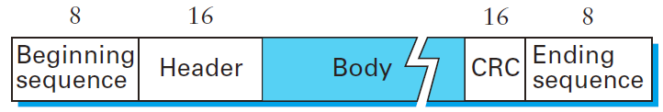
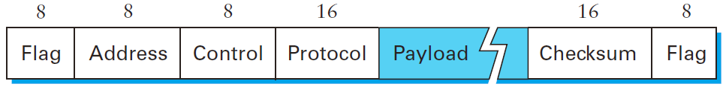
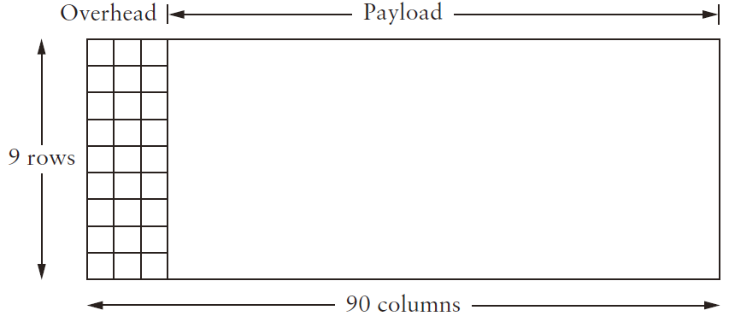
HDLC, PPP, and SONET
HDLC: Bit-Oriented Protocols
PPP: Byte-Oriented Protocols
SONET: Clock-Based Framing (per 125us)
Notes:
STS-1 (Synchronous Transport Signal): 8k×9×90×8 = 51.84 Mbps

Slide 18
HDLC
High level data link control
Station Types
Primary station
Controls operation of link, issues commands
Secondary station
Under control of primary station, issues responses
Combined (peer) station
Link Configurations
Unbalanced
One primary and several secondary stations
Balanced
Between 2 combined stations

Slide 19
HDLC Transfer Modes
Unbalanced configuration
Normal Response Mode
Secondary may only transmit data in response to command from primary
Host computer with many Terminals
Asynchronous Response Mode
Secondary may initiate transmission without permission form primary (rarely used)
Balanced configuration
Asynchronous Balanced Mode
Either station can initiate transmission

Slide 20
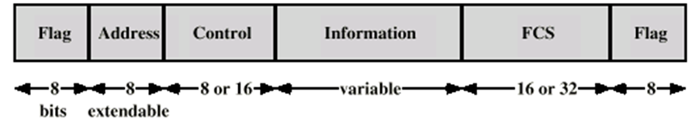
HDLC Frame Format
Flag
01111110, delimit frame at both ends
Bit Stuffing
Sending: 0 inserted after every sequence of five 1s in other fields
Receiving: after five 1s, if sixth is 0, delete 0; if sixth starts with 10, delimiter
Address
Identifies secondary stations, all 1s means broadcast

Slide 21
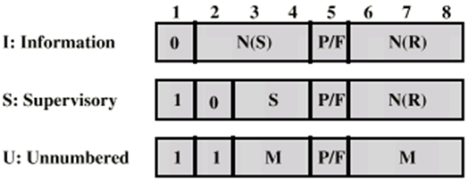
The Control Field
N(S): send sequence number
N(R): receive sequence number
S: supervisory function bits
M: unnumbered function bits
P/F: poll/final bit
Supervisory
Flow and error control (no sending data)
Receive Ready (RR), Receive Not Ready (RNR); Reject (REJ), Selective Reject (SREJ)
Unnumbered
Supplementary link control: setting modes, reset link
Poll/Final
If solicits response; and does be the (end of) response

Slide 22
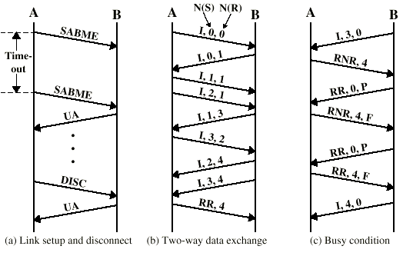
Examples of HDLC Operation
Notes:
SABME: Set asynchronous balanced extended mode
UA: Unnumbered Acknowledgment
DISC: Disconnect

Slide 23
PPP
Point-to-Point Protocol
Design requirements
Packet framing: encapsulation of network-layer datagram in data link frame
Bit transparency: carry any bit pattern in the data field
Connection liveness: detect, signal link failure to network layer
Network layer address negotiation: endpoint can learn/configure each other’s network address
Working upon different physical networks: PPPoE (Ethernet), PPPoA (ATM)

Slide 24
PPP
Non-requirements
No error correction/recovery
No flow control
May delivery out of order
No need to support multipoint links
Notes:
Error detection only (checksum)

Slide 25
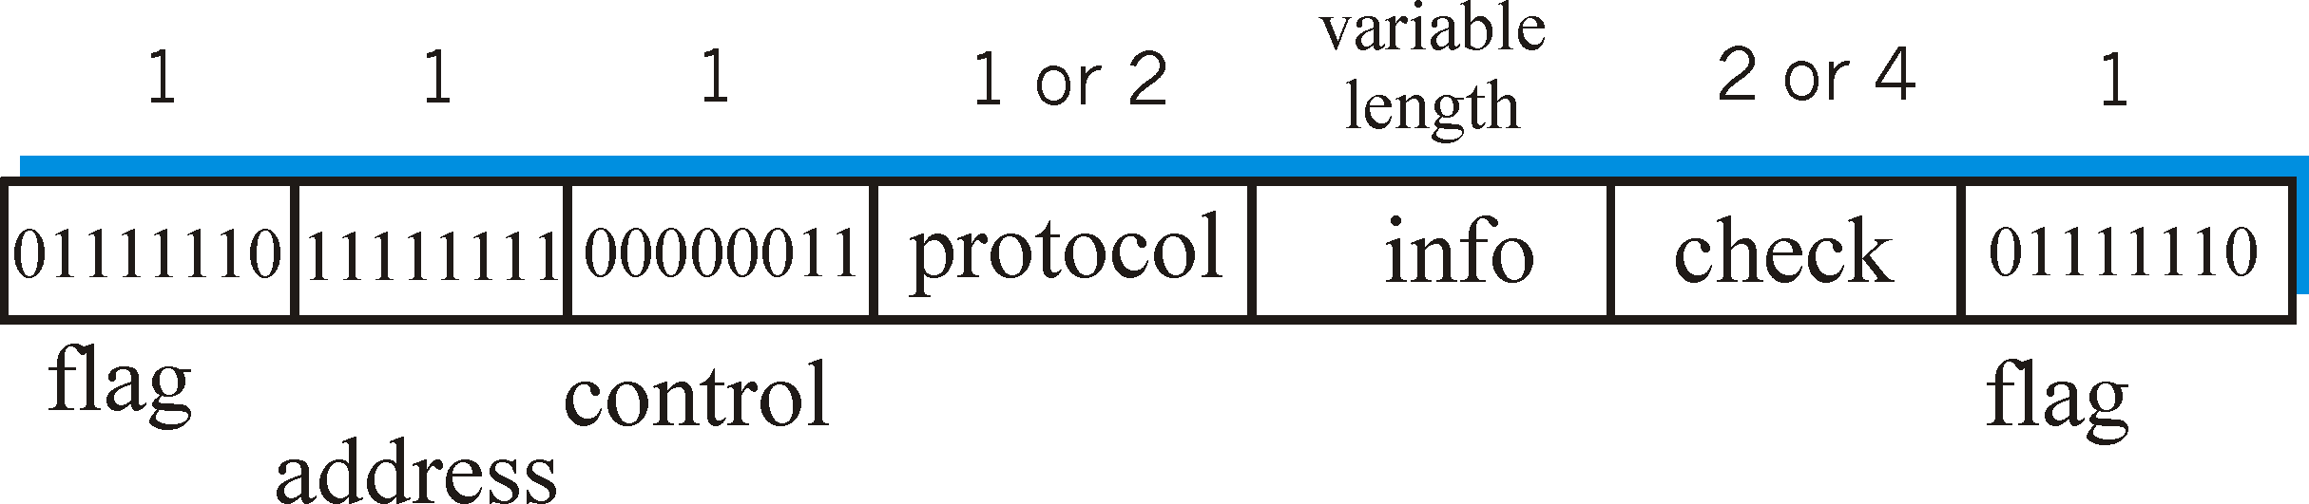
PPP Data Frame
Flag: delimiter
Address, Control: does nothing
Protocol: upper layer protocol (e.g. PPP-LCP, IP, IPCP)
Check: cyclic redundancy check
Notes:
LCP: Link Control Protocol for PPP
IPCP: Internet Protocol Control Protocol, a special LCP for IP

Slide 26
Byte Stuffing
Q: How to include flag pattern <01111110> in other fields
Sender:
Adds extra <01111110> (stuffs) after each <01111110> (byte)
Receiver:
Two <01111110> in a row: discard first byte, continue data reception
Single <01111110>: delimiter

Slide 27
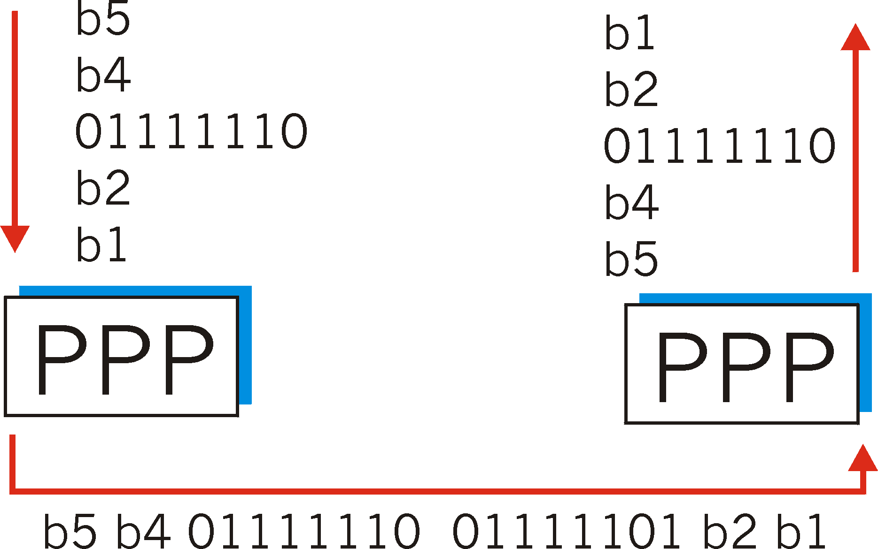
Byte Stuffing
Flag pattern
in data to send
Flag pattern plus stuffed byte in transmitted data

Slide 28
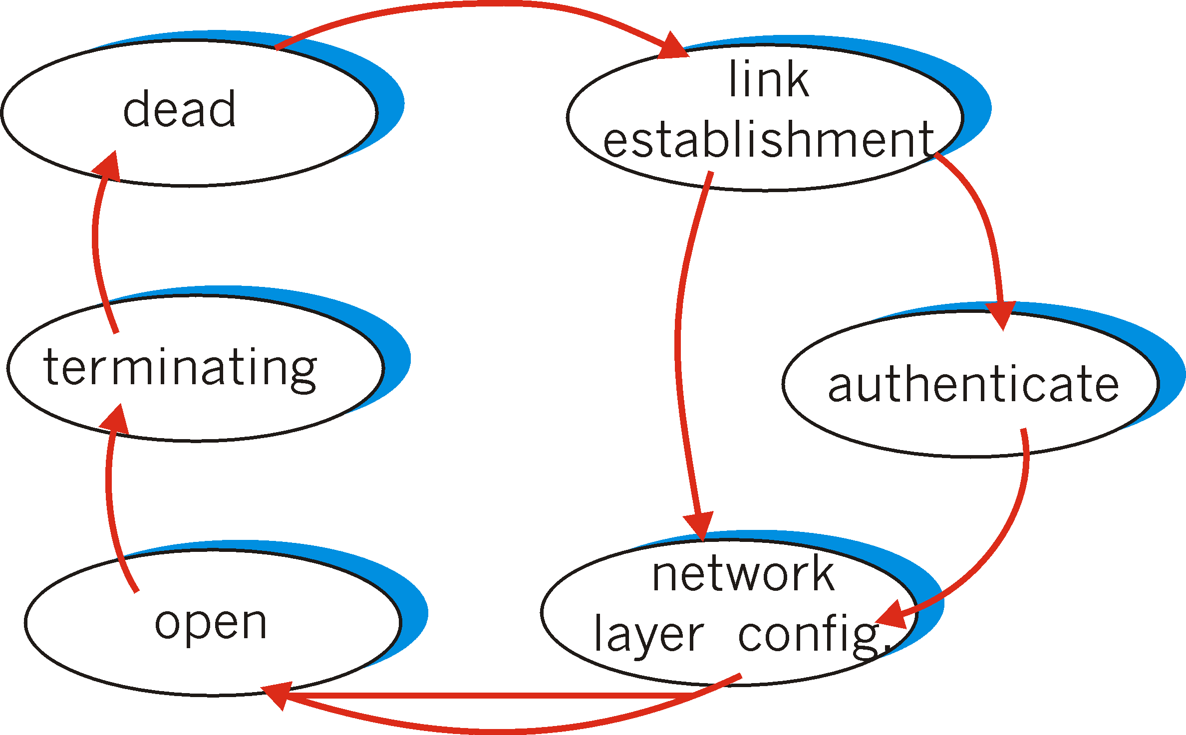
PPP Link Control Protocol
Before exchanging network-layer data, data link peers must
Configure PPP link (max. frame length, authentication)
Learn/configure network layer information

Slide 29
SONET/SDH
SONET: Synchronous optical networking, used in UA and Canada
SDH: synchronous digital hierarchy, used in the rest of the world
Transmission hierarchy
Synchronous Transport Signal level 1 (STS-1) or Optical Carrier level 1 (OC-1)
51.84Mbps
Multiple STS-1 combined into STS-N signal
Synchronous Transport Module level 1 (STM-1)
155.52Mbps, equivalent to STS-3c/OS-3c
Notes:
SONET: STS-1
SDH: STM-1

Slide 30
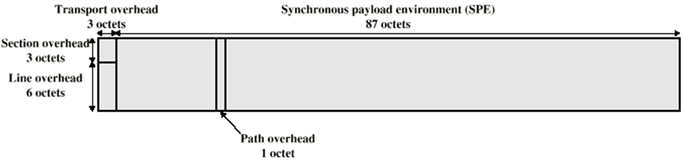
SONET Framing
/ 9 octets
/ 261 octets
Frame organized in rows, one frame per 125us
STS-1 frame
9 rows, each row has 3 octets overhead, followed by 87 octets of payload
STM-1 frame
9 rows, each row 9 octets overhead, 261 octets payload

Slide 31
SONET Overheads
Transport overhead
Section overhead
Frame structure required by the terminal equipment
Line overhead
Error correction, alarms and maintenance
Path (Payload) overhead
End-to-end signaling and error measurement

Slide 32
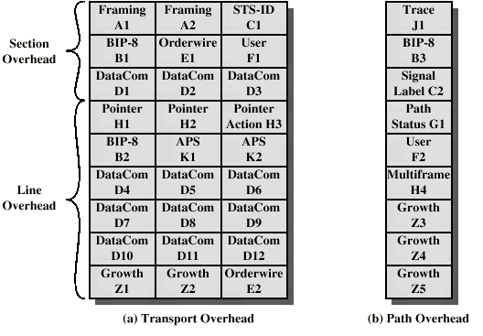
SONET Framing

Slide 33
Ethernet
Multiple access links
Random access protocols
CSMA/CD
IEEE 802.3
High-Speed Ethernet

Slide 34
Multiple Access Links
Shared wire or medium
Old-fashioned Ethernet
802.11 wireless LAN
Properties
Single shared broadcast channel
Two or more simultaneous transmissions by nodes: interference
Collision: node receives two or more signals at the same time

Slide 35
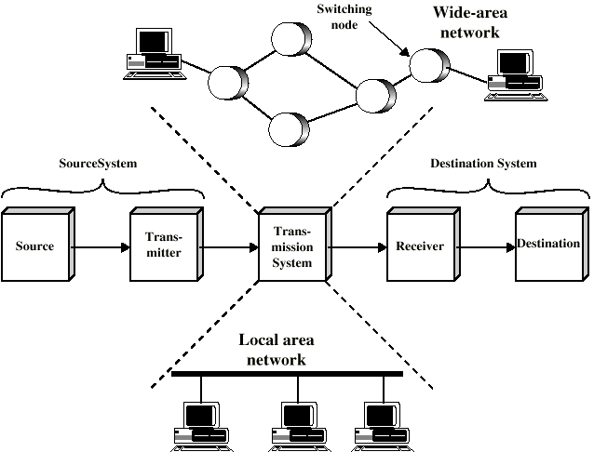
Local Area Network
Notes:
Out-dated

Slide 36
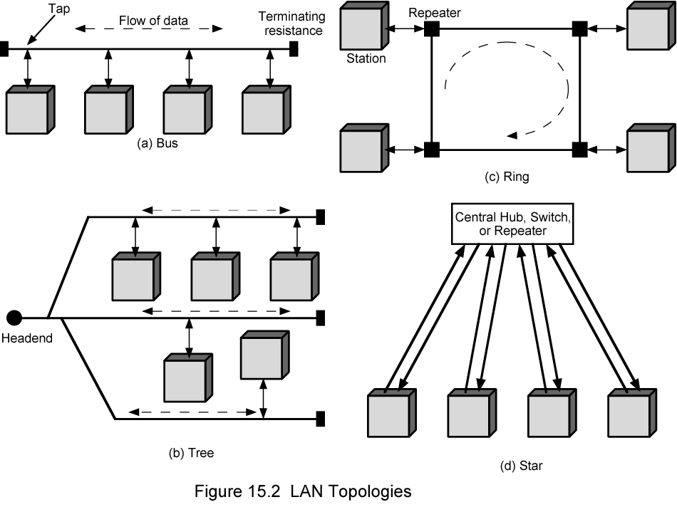
Different Topologies

Slide 37
Handling Multiple Access
Multiple access control (MAC)
Determine when node can transmit on shared media
Channel Partitioning
Divide channel into smaller “pieces” (time slots, frequency, code)
Allocate piece to node for exclusive use
Taking turns
Nodes take turns to transmit, nodes with more to send can take longer turns
Random Access
Channel not divided, allow collisions
Coordinate or recover from collisions

Slide 38
Channel Partitioning with TDMA
Access to channel in “slots and rounds”
Each station gets fixed length slot (packet trans time) in each round
Unused slots go idle
Example: a 6-station LAN, 1,3,4 have packets, slots 2,5,6 idle
6-slot
frame
1
3
4
1
3
4
Notes:
TDMA: time division multiple access

Slide 39
Channel Partitioning with FDMA
Channel spectrum divided into frequency bands
Each station assigned fixed frequency band
Unused transmission time in frequency bands go idle
Example: a 6-station LAN, 1,3,4 have packets, frequency bands 2,5,6 idle
time
frequency bands
FDM cable
Notes:
FDMA: frequency division multiple access

Slide 40
Channel Partitioning with CDMA
Code Division Multiple Access
Used in wireless broadcast channels (cellular, satellite, etc)
All nodes share same frequency, but each node has own “chipping” sequence (i.e., code set) to encode data
Encoded signal = (original data) × (chipping sequence)
Decoding = inner-product of encoded signal and chipping sequence
If codes are “orthogonal”
Multiple nodes can transmit simultaneously with minimal interference

Slide 41
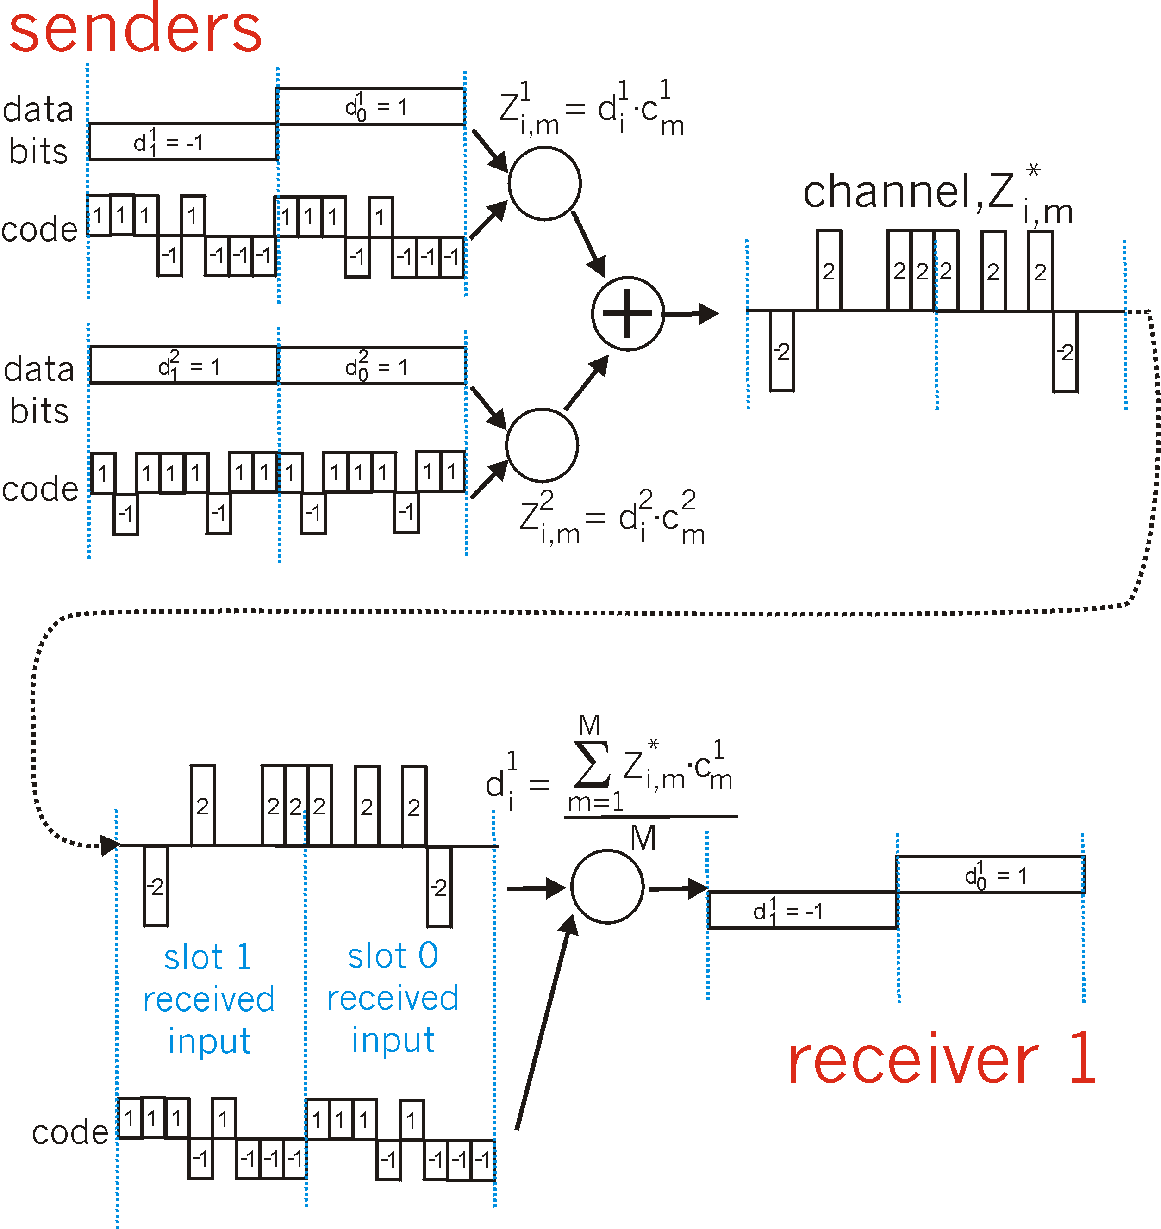
Channel Partitioning with CDMA

Slide 42
Taking Turns
Polling:
Master node “invites” slave nodes to transmit in turn
Typically used with “dumb” slave devices
Concerns:
Polling overhead
Latency
Single point of failure (master)
e.g. Bluetooth
data
poll
master
data
slaves

Slide 43
Taking Turns
Token passing:
Control token passed from one node to next sequentially
Token to message
Concerns:
Token overhead
Latency
Single point of failure (token)
IBM Token Ring, FDDI
T
(nothing
to send)
T
data

Slide 44
Random Access Protocols
When node has packet to send
Transmit at full channel data rate R
No priori coordination among nodes
Two or more transmitting nodes → collision
Random access MAC protocol specifies:
How to detect collisions
How to recover from collisions (e.g. via delayed retransmissions)
Examples of random access MAC protocols:
ALOHA, Slotted ALOHA
CSMA, CSMA/CD, CSMA/CA

Slide 45
ALOHA (1)
Additive Link On-line HAwaii system
Developed for Packet Radio networks by Hawaii University
Sender
When station has frame, it sends
Station listens (for max round trip time) plus small increment
If ACK, fine. If not, retransmit
If no ACK after repeated transmissions, give up
Notes:
无线网络

Slide 46
ALOHA (2)
Receiver
Use frame check sequence (as in HDLC)
If frame OK and address matches receiver, send ACK
Frame may be damaged by noise or collision
Another station transmitting at the same time
Any overlap of frames causes collision
Max utilization 18%

Slide 47
Illustration of ALOHA
Transmit OK
Collide, retransmit
1
6
Station 1
t
T₀
Collide, retransmit
Collide, retransmit again
2
5
Station 2
t
Collide, retransmit
Transmit OK
3
7
Station N-1
t
Transmit OK
4
Station N
t
1 2 3 4 5 6 7
Frames arrive
t
T₀
T₀
T₀
T₀
T₀
Notes:
T₀ – 传输+传播时间

Slide 48
Slotted ALOHA
All frames have same size
Time in uniform slots equal to frame transmission time (T₀)
Need central clock (or other sync mechanism)
Transmission begins at slot boundary
Frames either miss or overlap totally
Max utilization 37%

Slide 49
Illustration of Slotted-ALOHA
Transmit OK
Collide, retransmit
1
3
3’
Station 1
t
T₀
Collide, retransmit
2
4
4’
Station 2
t
T
T₀
Frame arrives
Node retransmits frame in each subsequent slot with prob. p until success

Slide 50
CSMA
Suppose
Propagation time is much less than transmission time
All stations know that a transmission has started almost immediately
Method
Sender listen for clear medium (carrier sense)
If medium idle, transmit
Wait reasonable time (round trip plus ACK contention)
No ACK then retransmit
Longer frame and shorter propagation gives better utilization

Slide 51
Nonpersistent CSMA
Station wishing to transmit listens
1. If medium is idle, transmit; otherwise, go to 2
2. If busy, wait amount of random time (delay) and repeat 1
Random delays reduces probability of collisions
Two stations waiting will take different time to begin transmission
Capacity is wasted, since medium will remain idle following end of transmission
Even if one or more stations waiting
Nonpersistent stations are deferential

Slide 52
1-persistent CSMA
To avoid idle channel time, 1-persistent protocol used
Station wishing to transmit listens
1. If medium idle, transmit; otherwise, go to step 2
2. If medium busy, listen until idle; then transmit immediately
1-persistent stations selfish
If two or more stations waiting, collision guaranteed

Slide 53
p-Persistent CSMA
Try making compromise
Attempts to reduce collisions like Nonpersistent
And reduce idle time like 1-persistent
Rules
1. If medium idle, transmit with probability p, and delay one time unit with probability (1–p)
Typically, time unit = maximum propagation delay
2. If medium busy, listen until idle and repeat step 1
3. If transmission is delayed one time unit, repeat step 1
What is an effective value of p?

Slide 54
Value of p
Objective: avoid instability under heavy load
Suppose: N stations waiting to send
The best value of p in theory is 1/N
If heavy load expected, p small
However, as p made smaller, stations wait longer
In general, this gives very long delays

Slide 55
Different Types of CSMA
Notes:
发送时空闲
发送时不空闲
冲突处理

Slide 56
CSMA/CD
With CSMA, collision occupies medium for duration of transmission
Colliding transmissions aborted once detected
Stations listen whilst transmitting
1. If medium idle, transmit; otherwise, step 2
2. If busy, listen for idle, then transmit immediately
3. If collision detected, jam then cease transmission
4. After jam, wait random time then start from step 1

Slide 57
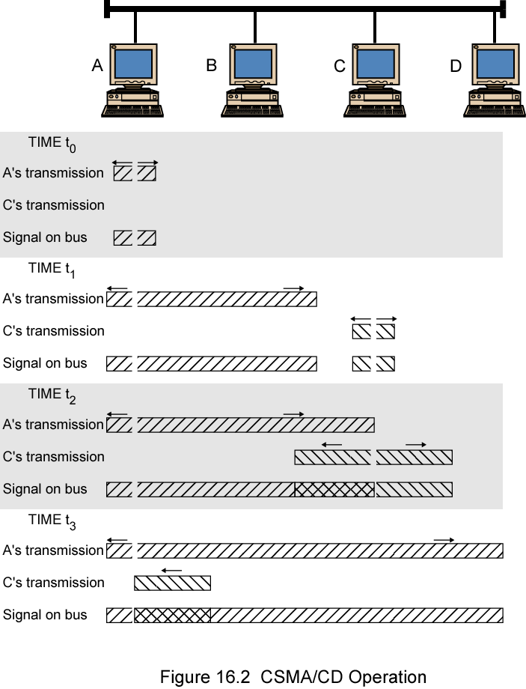
CSMA/CD Operation
C end transmission here
A end transmission here

Slide 58
The Persistence Algorithm
IEEE 802.3 uses 1-persistent
Both non-persistent and p-persistent have performance problems
Collision handling for 1-persistent
Wasted time due to collisions is short (if frames long relative to propagation delay
With random backoff, unlikely to collide on next tries
Binary exponential backoff used

Slide 59
Binary Exponential Backoff
Attempt to transmit repeatedly if repeated collisions
First 10 attempts, mean value of random delay doubled
Value then remains same for 6 further attempts
After 16 unsuccessful attempts, station gives up and reports error
1-persistent algorithm with binary exponential backoff efficient over wide range of loads
Low loads, 1-persistence guarantees efficiency
High loads, at least as stable as other techniques
Backoff algorithm gives last-in, first-out effect
Stations with few collisions transmit first
Notes:
阻止新帧的发送

Slide 60
Collision Detection
On baseband bus, collision produces much higher signal voltage than signal
Collision detected if cable signal greater than single station signal
Signal attenuated over distance
Jam needed
Limit distance to 500m (10Base5) or 200m (10Base2)
For twisted pair (star-topology) activity on more than one port is collision
Special collision presence signal
Notes:
集线hub：两个以上端口有数据
交换hub：数据发向同一端口、其中某个需要广播

Slide 61
IEEE 802.3 Transmission Algorithm
time unit (512 bit time) for retransmission
Retry count
Inter frame gap for receiver

Slide 62
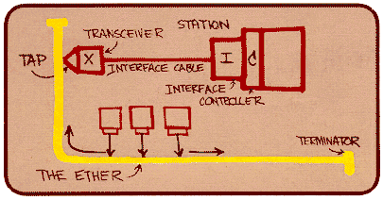
Ethernet
“Dominant” wired LAN technology:
First widely used LAN technology
Simpler, cheaper than token LANs and ATM
Keep up with speed race: 10 Mbps ~ 10 Gbps
Metcalfe’s Ethernet
sketch

Slide 63
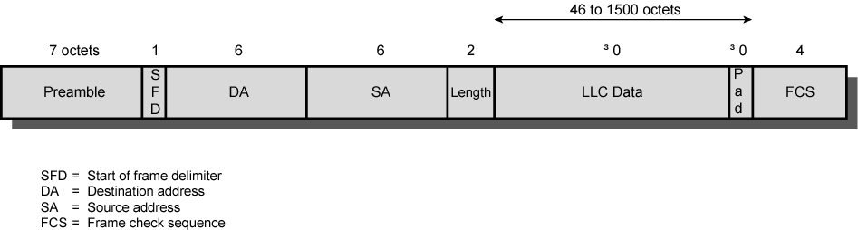
Frame Format
Ethernet v2 MAC frames
Preamble
DA
SA
Type
Data
FCS
8 octets
6
6
2
46~1500
4
IEEE 802.3 MAC frames

Slide 64
Ethernet Frame
Preamble
7 octets with pattern 10101010 followed by one octet with pattern 10101011
Used to synchronize receiver, sender clock rates
Addresses
6 octets MAC addresses
e.g. 08:00:2b:e4:b1:02 stands for 00001000 00000000 00101011 11100100 10110001 00000010
Type/Length
Indicates higher layer protocol, IP, Novell IPX, AppleTalk
Or length of LLC data (in IEEE 802.3)
FCS
CRC checked at receiver

Slide 65
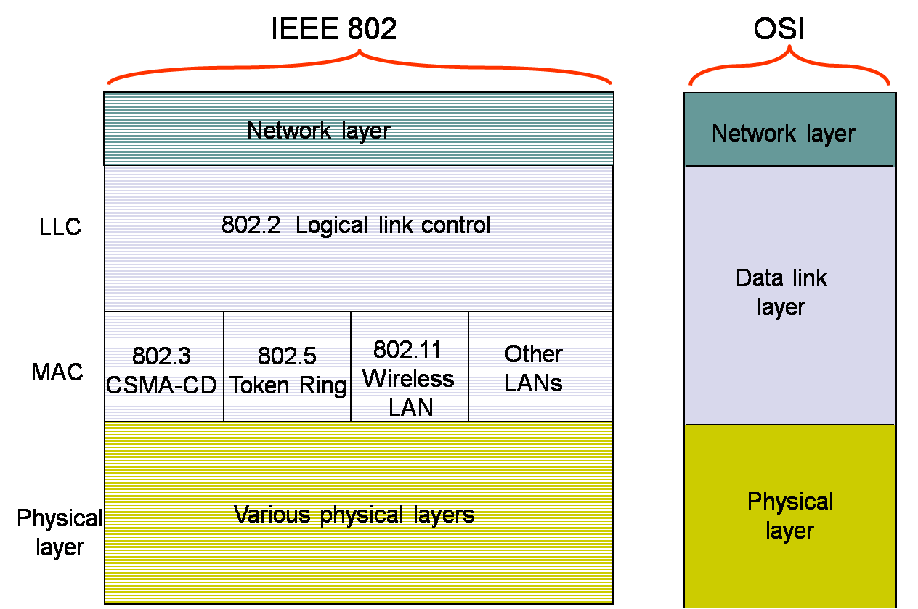
IEEE 802.3

Slide 66
IEEE 802 – Logical Link Control
Ethernet: Unreliable and connectionless
No handshaking between sending and receiving NICs
Receiver doesn’t send ACK or NAK to sender
Logical Link Control
Handle logical links between the stations
Flow and error control
Never used on Ethernet, but on WiFi and Token Ring
Notes:
Network Interface Card

Slide 67
LLC Services
Based on HDLC, 3 defined:
Unacknowledged connectionless service
Nothing added
Acknowledged connectionless service
Add ACK and NAK, stop-and-wait
Connection mode service
HDLC in Asynchronous balanced mode

Slide 68
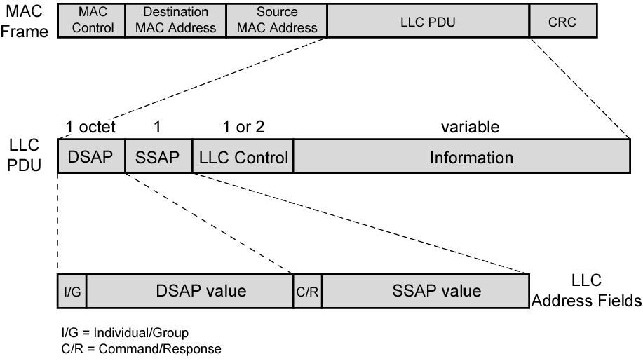
LLC PDU and MAC Frame
Notes:
Protocol Data Unit

Slide 69
802.3 Physical Layer
 | 10base5 | 10base2 | 10baseT | 10baseFX
Medium | Thick coax | Thin coax | Twisted pair | Optical fiber
Max. Segment Length | 500 m | 200 m | 100 m | 2 km
Topology | Bus | Bus | Star | Point-to-point link
(a)
(b)
transceivers
Thick Coax: Stiff, hard to work with
T connectors flaky

Slide 70
802.3 Physical Layer
Single collision domain
(c)
●     
Twisted Pair Cheap
Easy to work with
Reliable

Slide 71
High-Speed Ethernet
Still use IEEE 802.3 MAC protocol and frame format
Star topology
Speedup by modern wiring and signaling techniques
100Mbps Fast Ethernet
Gigabit Ethernet
10Gbps Ethernet

Slide 72
100Mbps Fast Ethernet
100BASE-TX
2 pairs of twisted-pair cable (STP and Category 5 UTP)
MLT-3 signaling scheme
100BASE-FX
2 optical fiber cables
4B/5B-NRZI code group stream
100BASE-T4
4 pairs of Cat. 3 or Cat. 5 UTP
Data stream split into 3 separate streams
Ternary signaling scheme (8B6T)
Notes:
Unshielded/Shielded Twisted Pair

Slide 73
100Mbps Fast Ethernet
 | 100BASE-TX |  | 100BASE-FX | 100BASE-T4
Medium | 2 pair, STP | 2 pair, cat 5 UTP | 2 optical fibre | 4 pair, cat 3,4,5 UTP
Signaling | MLT-3 | MLT-3 | 4B5B, NRZI | 8B6T, NRZ
Transmission Rate | 100 Mbps
Topology | Star
Max Length (m) | 100 | 100 | 200 | 100
Network Span (m) | 200 | 200 | 400 | 200

Slide 74
Gigabit Ethernet
Carrier extension
At least 4096 bit-times long
Frame bursting
Treat multiple small frames as a large one
Full Duplex Operation
Must use switching hub
Each station constitutes separate collision domain

Slide 75
Gigabit Physical Layer
1000Base-SX
Short wavelength, multi mode fiber
1000Base-LX
Long wavelength, multi or single mode fiber
1000Base-CX
Copper jumpers <25m, shielded twisted pair
1000Base-T
4 pairs, cat 5 UTP
Signaling
Fiber: 8B/10B; UTP: 4D-PAM5

Slide 76
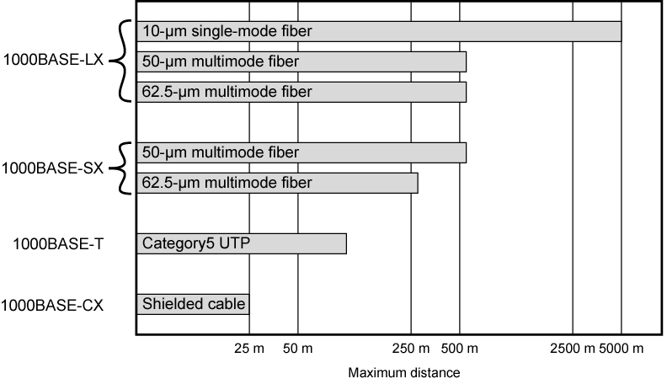
Gigabit Distance Options

Slide 77
10Gbps Ethernet
Full-duplex mode only
10GBASE-S (short)
850 nm on multi-mode fiber, Up to 300 m
10GBASE-L (long)
1310 nm on single-mode fiber, Up to 10 km
10GBASE-E (extended)
1550 nm on single-mode fiber, Up to 40 km
10GBASE-LX4
1310 nm on single-mode or multimode fiber, Up to 10 km
Wavelength-division multiplexing (WDM) bit stream across 4 light waves
Notes:
光波的波长
LX4: 4个不同波长光波通过单个光纤
单模和多模：
光模式是指光线传输横截面和纵截面的电磁场结构图形。每个模在光纤轴附近以不同的传播常数和群速度传播，拥有独立的横向模场分布和偏振态。
当光纤纤芯直径很小时，光纤内对给定工作波长只能传播一个模式，称为单模光纤
纤芯直径较大的光纤可传输多个模式，称为多模光纤
CCITT建议单模光纤与多模光纤的外径（包层直径）均为125μm，多模光纤芯径50μm，单模光纤芯径8~10μm。

Slide 78
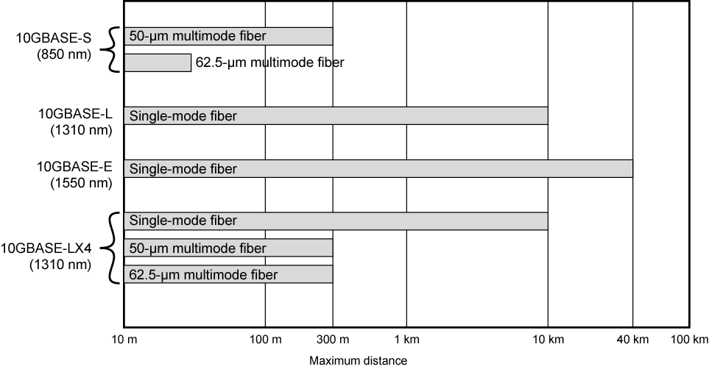
10Gbps Ethernet Distance Options

Slide 79
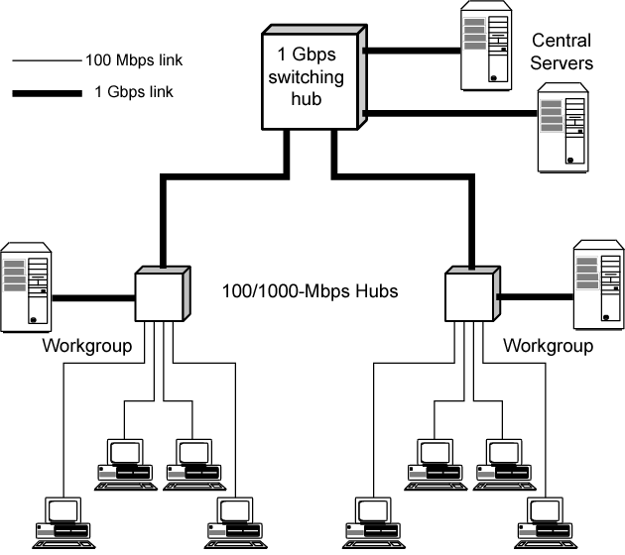
Gigabit Ethernet Configuration

Slide 80
Token Ring
Developed from IBM's commercial token ring
Because of IBM's presence, token ring has gained broad acceptance
Currently, large installed base of token ring products
Never achieved popularity of Ethernet

Slide 81
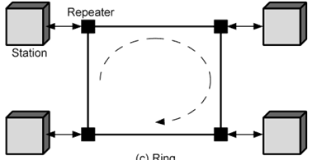
Ring Operation
Each repeater connects to two others via unidirectional transmission links
Repeater acts as attachment point
Data transferred bit by bit from one repeater to the next
Repeater regenerates and retransmits each bit
Repeater performs data insertion, data reception, data removal
Frame removed by transmitter after one trip round ring

Slide 82
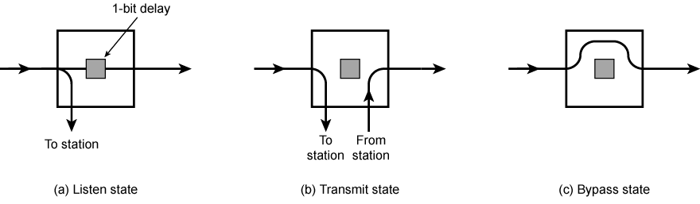
Ring Repeater States
Transmit state
Reclaim frame and pass back to station for checking (ACK)
May buffer other’s frame for retransmission later
Bypass state
Do nothing more than a connector

Slide 83
Listen State Functions
Scan passing bit stream for patterns
Address of attached station vs. destination address
Token permission to transmit
Copy incoming bit and send to attached station
If destination address matched
Whilst forwarding each bit
Modify bit as it passes
e.g. to indicate a packet has been copied (ACK)
Or make reservation
Notes:
或标注有帧需要发送
识别到错误

Slide 84
802.5 MAC Protocol
Small frame (token) circulates when idle
Station waits for token
Changes one bit in token to make it SOF for data frame
Append rest of data frame
Frame makes round trip and is absorbed by transmitting station
Station then inserts new token when transmission has finished (leading edge of returning frame arrives)
Under light loads, some inefficiency
Under heavy loads, round robin
Notes:
SOF: Start of Frame

Slide 85
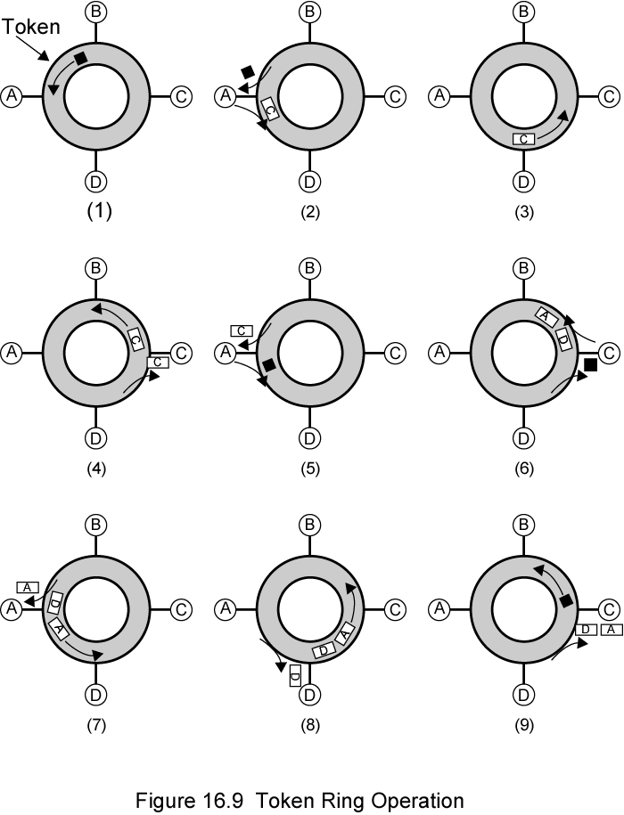
Token Ring Operation

Slide 86
FDDI
100 Mbps Token Ring
Use multi-mode or single-mode optical fiber transmission links
Span up to 200 kms and permits up to 500 stations
LAN and MAN applications

Slide 87
FDDI Token Ring
A
E
B
C
D
Notes:
内环平时闲置，用于容错

Slide 88
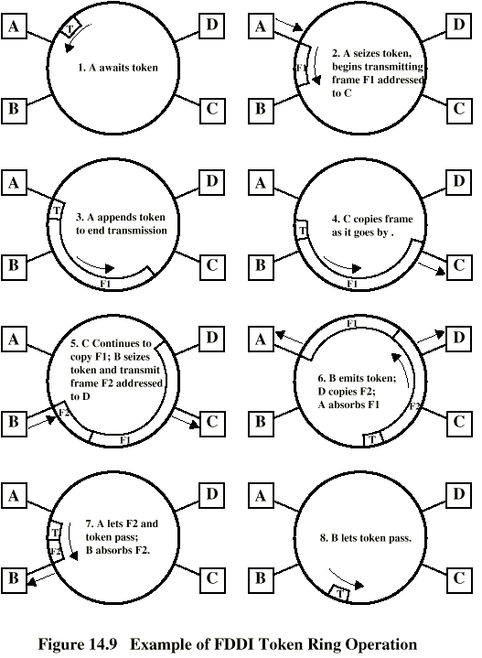
FDDI Operation

Slide 89
Token Ring Frame Format (1)
Data frame format
1
1
1
6
6
4
1
1
SD
AC
FC
Destination
address
Source
address
Information
FCS
ED
FS
Token frame format
SD
AC
ED
Starting
delimiter
J, K non-data symbols (line code)
J begins as "0" but no transition
K begins as "1" but no transition
J K 0 J K 0
0
0
Access
control
PPP=priority; T=token bit
M=monitor bit; RRR=reservation
T=0 token; T=1 data
P P P
T
M
R R R
Ending
delimiter
I = intermediate-frame bit
E = error-detection bit
J K 1 J K 1
I
E

Slide 90
Token Ring Frame Format (2)
Data frame format
1
1
1
6
6
4
1
1
SD
AC
FC
Destination
address
Source
address
Information
FCS
ED
FS
Frame
control
FF = frame type; FF=01 data frame
FF=00 MAC control frame
ZZZZZZ type of MAC control
F F
Z Z Z Z Z Z
Addressing
48 bit format as in 802.3
Information
Length limited by allowable token holding time
FCS
CCITT-32 CRC
Frame
status
A = address-recognized bit
xx = undefined
C = frame-copied bit
A
C
x x
A
C
x x
Notes:
控制帧：令牌生成/恢复、无主帧识别、同步

Slide 91
FDDI Frame Format
Token Frame Format
PRE
SD
FC
ED
Data Frame Format
8
1
1
2 or 6
2 or 6
4
1
1
PRE
SD
FC
Destination
Address
Source
Address
Information
FCS
ED
FS
Preamble
Frame
Control
CLFFZZZZ C = Sync / Async
L = Address length (16 or 48 bits)
FF = LLC/MAC control/reserved frame type
No AC field
FC changed
Add PRE field
DA and SA changed

Slide 92
802.5 Physical Layer
Data Rate (Mbps) | 4 | 16 | 100 | 100 | 1000
Medium | UTP, STP, Fiber | UTP, STP, Fiber | UTP, STP | Fiber | Fiber
Signaling | Differential Manchester | Differential Manchester | MLT-3 | 4B5B NRZI | 8B/10B
Max Frame Len | 4,550 | 18,200 | 18,200 | 18,200 | 18,200
Access Control | TR or DTR | TR or DTR | DTR | DTR | DTR
Note: 1 Gbit specified in 2001
Uses 802.3 physical layer specification
Notes:
bit length

Slide 93
Bridges and Layer-2 switch
Ability to expand beyond single LAN
Provide interconnection to other LANs/WANs
Bridge is used (later Layer-2 switch)
Connects LANs, usually more than two LANs
Identical protocols for physical and MAC layers
Store, forward LAN frames
Exact bitwise copy of frame
Switch (route) functions needed
Notes:
LAN在主机数量和地域范围方面有限制
多台主机构成不同的团体
安全、布线等方面的考虑

Slide 94
Requirements of a Bridge
Store and Forward
Read frames transmitted on one LAN, Examine frames’ MAC address, selectively store those address to other LANs
Using MAC protocol of second LAN, retransmit each frame
Transparent
Stations are unaware of presence of bridges
Plug-and-play, self-learning
Bridges do not need to be configured

Slide 95
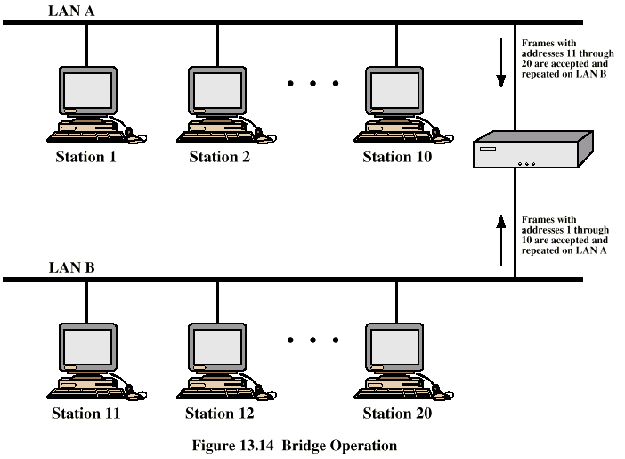
Bridge Operation

Slide 96
Bridge Protocol Architecture
IEEE 802.1D, MAC level
Use MAC address for switching
Bridge does not need LLC layer
Relaying MAC frames
Can pass frame over external WAN or links
Capture LAN frame, encapsulate it
Forward it across WAN link
Remove encapsulation and forward over LAN link
Notes:
Wide Area Network
Frame Relay

Slide 97
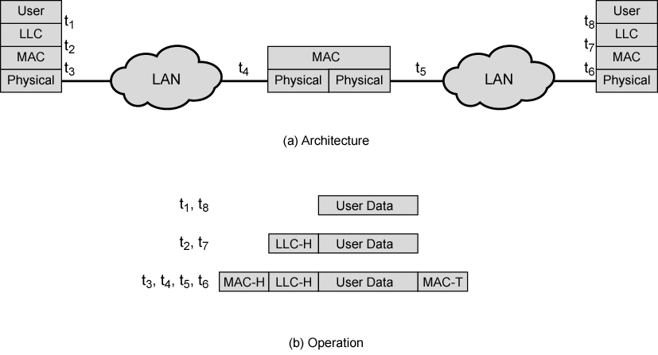
A Simple Connection of LANs

Slide 98
Routing for Bridges
Complex LANs configuration cause alternative routes
Bridge must decide (Switching)
Whether to forward frame
Which LAN to forward frame on
Fixed routing for each source-destination pair of LANs
Done in configuration
Station cannot be moved
Notes:
1、网桥无法达到负载均衡等的要求
2、固定路由不甚可行：a. MAC地址不能识别网段；b. MAC地址不应和网段绑定

Slide 99
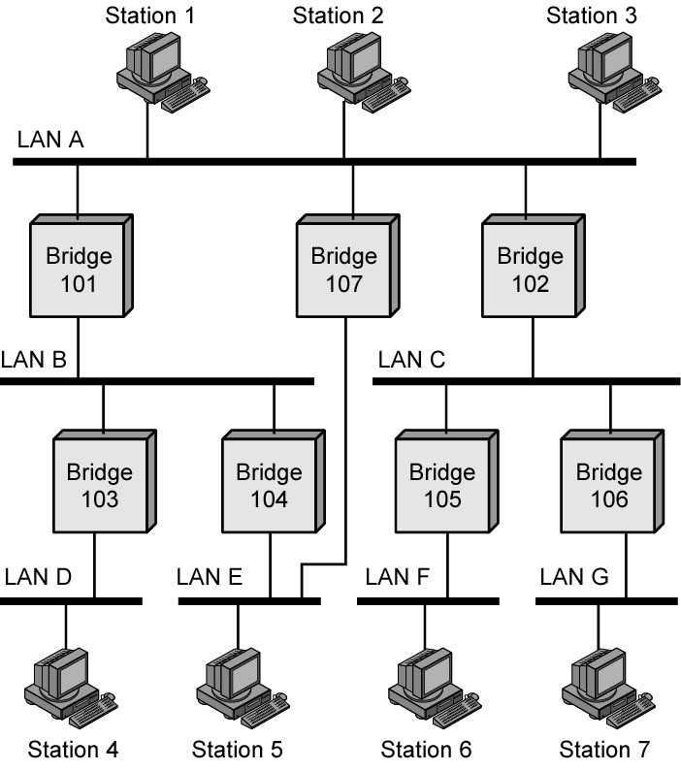
Bridges and LANs with Alternative Routes
1
5

Slide 100
Spanning Tree
Bridge automatically develops switching table
Automatically update in response to changes
Frame forwarding
Address learning
Loop resolution

Slide 101
Frame forwarding
Maintain forwarding database for each port
<Mac Address, Port, Timestamp>: station addresses reached through each port
For a frame arriving on port X
Search forwarding database to see if dest MAC address is listed for any port:
If address not found, forward to all ports (flooding) except X
If address listed for port X, drop it
If address listed for port Y, check port Y for Blocking or Forwarding state, transmit if Forwarding state
Blocking used to form a tree

Slide 102
Address Learning
Forwarding database can be learned
When frame arrives at port X, it has come from the LAN attached to port X
Use the source address to update forwarding database for port X to include that address
Timer on each entry in database, Entry deleted when timer is off
Each time frame arrives, source address checked against forwarding database

Slide 103
S1
S2
S3
S4
S5
LAN1
LAN2
LAN3
B1
B2
Port 1
Port 2
Port 1
Port 2
Address Port
Address Port

Slide 104
S1→S5
S1
S2
S3
S4
S5
S1→S5
S1→S5
S1→S5
S1→S5
LAN1
LAN2
LAN3
B1
B2
Port 1
Port 2
Port 1
Port 2
Address Port
Address Port
S1
1
S1
1

Slide 105
S3→S2
S1
S2
S3
S4
S5
S2←S3
S3→S2
S3→S2
S2←S3
S3→S2
LAN1
LAN2
LAN3
B1
B2
Port 1
Port 2
Port 1
Port 2
Address Port
Address Port
S1
1
S1
1
S3
2
S3
1

Slide 106
S4→S3
S1
S2
S3
S4
S5
S3←S4
S3←S4
LAN1
S3←S4
LAN2
LAN3
B1
B2
Port 1
Port 2
Port 1
Port 2
Address Port
Address Port
S1
1
S1
1
S3
2
S3
1
S4
2
S4
2

Slide 107
S2→S1
S1
S2
S3
S4
S5
S2→S1
LAN1
S2→S1
LAN2
LAN3
B1
B2
Port 1
Port 2
Port 1
Port 2
Address Port
Address Port
S1
1
S1
1
S3
2
S3
1
S4
2
S4
2
S2
1

Slide 108
Spanning Tree
Address learning works for tree layout
i.e. no closed loops
Spanning tree
A tree that maintains connectivity but contains no loops for any connected graph
Each bridge assigned unique identifier
Exchange between bridges to establish spanning tree

Slide 109
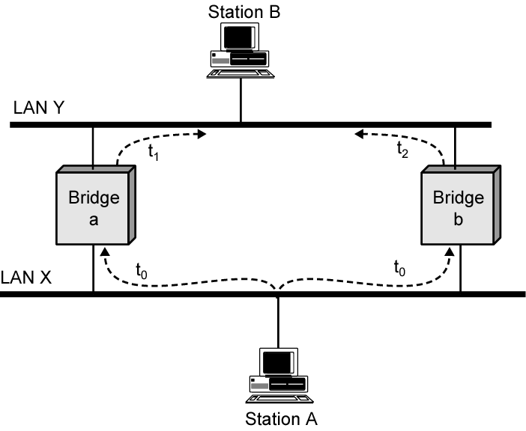
Loop of Bridges
Bridge a, b not know where Station B is
Notes:
绕圈子
转发(路由)表抖动

Slide 110
The Algorithm
Select a root bridge among all the bridges
Root bridge = the lowest bridge ID
Determine the root port for each bridge except the root bridge
Root port = port with the least-cost path to the root bridge
Select a designated bridge for each LAN
Designated bridge = bridge with the least-cost path from the LAN to the root bridge
Designated port connects the LAN with the designated bridge
All root ports and all designated ports are placed into a forwarding state
The other ports are placed into a blocking state

Slide 111
LAN1
(1)
(1)
B1
B2
(1)
(2)
(2)
(3)
B3
LAN2
(1)
(2)
B4
(2)
LAN3
(1)
B5
(2)
LAN4

Slide 112
LAN1
(1)
(1)
Bridge 1 selected as root bridge
B1
B2
(1)
(2)
(2)
(3)
B3
LAN2
(1)
(2)
B4
(2)
LAN3
(1)
B5
(2)
LAN4

Slide 113
LAN1
(1)
R
(1)
Root port selected for every bridge except root bridge
B1
B2
R
(1)
(2)
(2)
(3)
B3
LAN2
R
(1)
(2)
B4
(2)
LAN3
R
(1)
B5
(2)
LAN4

Slide 114
LAN1
D
(1)
R
(1)
Select designated bridge for each LAN
B1
B2
R
(1)
D
(2)
(2)
(3)
B3
LAN2
R
(1)
(2)
D
D
B4
(2)
LAN3
R
(1)
B5
(2)
LAN4

Slide 115
LAN1
D
(1)
R
(1)
All root ports & designated ports put in forwarding state
B1
B2
R
(1)
D
(2)
(2)
(3)
B3
LAN2
R
(1)
(2)
D
D
B4
(2)
LAN3
R
(1)
B5
(2)
LAN4
Notes:
试证明为什么该算法不会产生环

Slide 116
Source Routing Bridges
To interconnect IEEE 802.5 token rings
The source station determines route to destination
Routing information inserted in frame
Routing
Route 1
Route 2
Route m
control
designator
designator
designator
2 bytes
2 bytes
2 bytes
2 bytes
Destination
Source
Routing
Data
FCS
address
address
information

Slide 117
Route Discovery
For a destination each station broadcasts a single-route broadcast frame
The frame visits every LAN once & eventually reaches destination
Destination sends all-routes broadcast frame which generates all routes back to source
Source collects routes & picks best

Slide 118
Detailed Route Discovery (Source)
Bridges must be configured to form a spanning tree
Source sends single-route frame without route designator field
Bridges in first LAN add <incoming LAN #, bridge #, outgoing LAN #> into frame & forwards
Each subsequent bridge attaches <bridge #, outgoing LAN #>
Eventually, one single-route frame arrives at destination

Slide 119
Detailed Route Discovery (Destination)
When destination receives single-route broadcast frame it responds with all-routes broadcast frame
Bridge at first hop inserts <incoming LAN #, bridge #, outgoing LAN #> and forwards
Subsequent bridges insert <bridge #, outgoing LAN #> and forward
Before forwarding, bridge checks to see if outgoing LAN already in designator field
Source eventually receives all routes to destination station

Slide 120
Find Routes from S1 to S3
LAN 2
B4
LAN 4
S1
B1
S2
LAN 1
B5
B3
B7
B2
S3
LAN 3
B6
LAN 5
B3
LAN3
B6
LAN5
LAN1
B1
LAN2
B4
LAN4

Slide 121
LAN 2
B4
LAN 4
S1
B1
S2
LAN 1
B3
B5
B7
B2
S3
LAN 3
B6
LAN 5
B3
B2
LAN1
B1
LAN2
B5
B4
LAN4
B7
B6
LAN3
B1
LAN1
B2
B3
LAN2
B5
B4
LAN4
B7
B4
LAN2
B1
LAN1
B2
B5
LAN4
B3
LAN5
B7
B3
B1
LAN1
B2
LAN3
B5
B4
LAN2
B6
B2
LAN1
B1
B7
LAN4
B3
LAN3
B5
B6
B3
B2
LAN1
B1
LAN2
B4
B5
LAN3
B3
LAN2
B1
LAN1
B2
B6
B4
Notes:
全路径广播帧不知道S1在LAN1

Slide 122
Hubs and Switches
Other types of devices for interconnecting LANs
Hubs: physical repeaters
Layer 2 switches: involving bridge functions
Layer 3 switches: involving router functions

Slide 123
Hubs
Active central element of star layout
Each station connected to hub by two lines
Transmit and receive
Hub acts as a repeater
When a station transmits, hub repeats signal on outgoing line to all other stations
Physically star, logically bus
Transmission from any station received by all other stations
If two stations transmit at the same time, collision

Slide 124
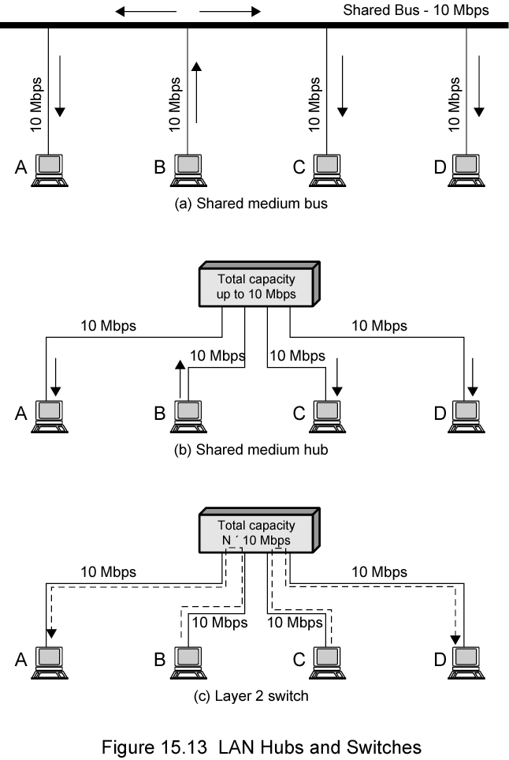
Shared Medium Bus and Hub

Slide 125
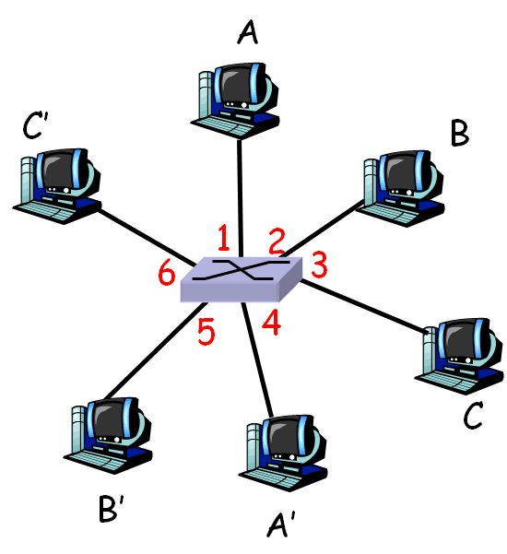
Layer 2 Switches
Stations have dedicated, direct connection to switch
Each port/link forms a LAN segment (no collisions)
Switches buffer and forward frames
Incoming frame from particular station switched to appropriate output line
More than one station transmitting at a time
Multiplying capacity of LANs

Slide 126
Shared Medium Hub and Layer 2 Switch
20M instead of 10M

Slide 127
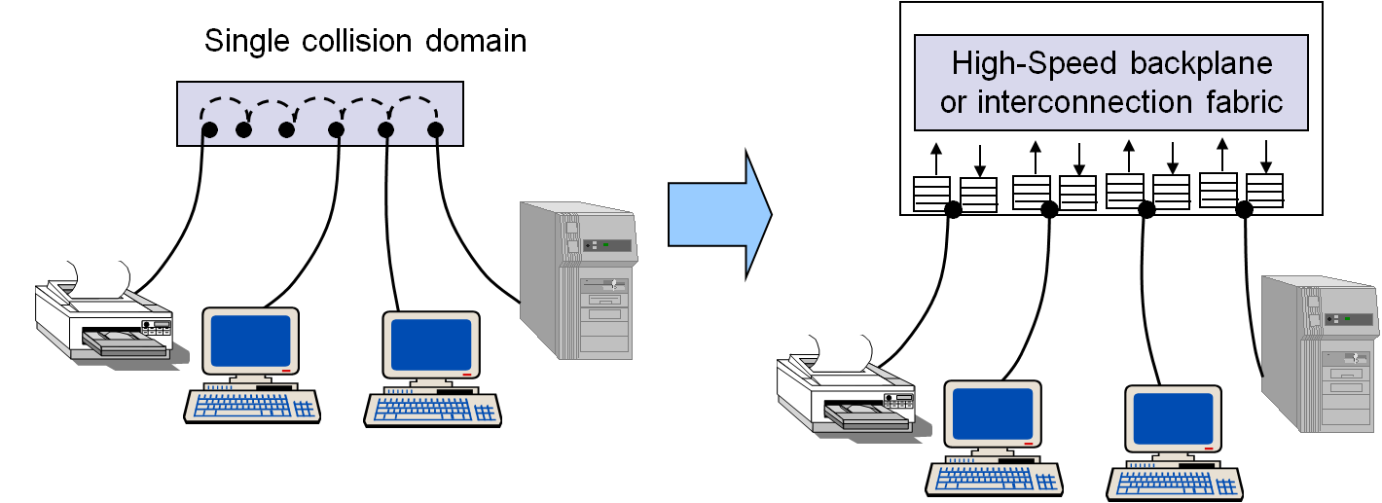
Shared Medium Hub and Layer 2 Switch

Slide 128
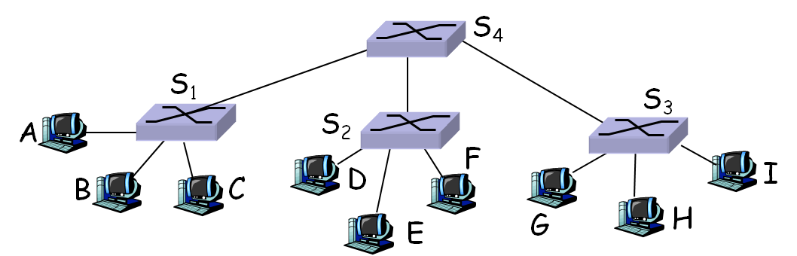
Layer 2 Switch Benefits
No change to attached stations to convert bus/hub LAN to switched LAN
For Ethernet LAN, each station uses Ethernet MAC protocol
Station has dedicated capacity equal to original LAN
Assuming switch has sufficient capacity to keep up with all stations
Layer 2 switch scales easily
New layer 2 switch added to accommodate additional stations
Notes:
or number of

Slide 129
Types of Layer 2 Switch
Store-and-forward switch
Accepts frame on input line
Buffers and routes it to appropriate output line
Adds delay between sender and receiver while boosts integrity of network
Cut-through switch
Takes advantage of dest address appearing at beginning of frame
Begins repeating frame onto output line as soon as it recognizes dest address
Highest possible throughput
Risk of propagating bad frames: unable to check CRC prior to retransmission

Slide 130
Layer 3 Switches
As number of stations grows, layer 2 switches reveal inadequacies
Broadcast overload
Lack of multiple paths
Layer 3 switch
Implement packet-forwarding (IP) logic of a router in hardware
Interconnecting similar LANs, as in layer 2 switches
Notes:
IP许多协议利用广播，如ARP、组管理
网桥广播转发

Slide 131
Broadcast Overload
Set of stations and LANs connected by layer 2 switches builds singular physical net
All nodes share common MAC broadcast address
Broadcast frame delivered to all stations attached to LANs connected by layer 2 switches
Under broadcast, layer 2 switches become hubs
IP causes many broadcasts under daily work, e.g. ARP, DHCP, IGMP
Notes:
Address Resolution Protocol
Dynamic Host Configuration Protocol
Internet Group Management Protocol

Slide 132
Lack of Multiple Paths
Layer 2 switches uses spanning tree for routing (switching)
Dictate no closed loops: only one path between any two stations
Limits both performance and reliability
Solution:
Break up LANs into sub-networks connected by switches using router functions (layer 3 switch)
MAC broadcast frames limited to single sub-network
Allow use of multiple paths between sub-networks
Notes:
Spanning Tree完全依照静态信息
不能根据拥塞等动态选路

Slide 133
Two Categories of Layer 3 Switches
Packet by packet
Operates in same way as traditional router
Order of magnitude increase in performance compared to software-based router
Flow-based switch tries to enhance performance by identifying flows of IP packets
Same source and destination
Done by using a special flow label in packet header
Once flow is identified, predefined route can be established
Notes:
提供“面向连接”的服务
由初始转发IP数据报的3级交换机识别并标注

Slide 134
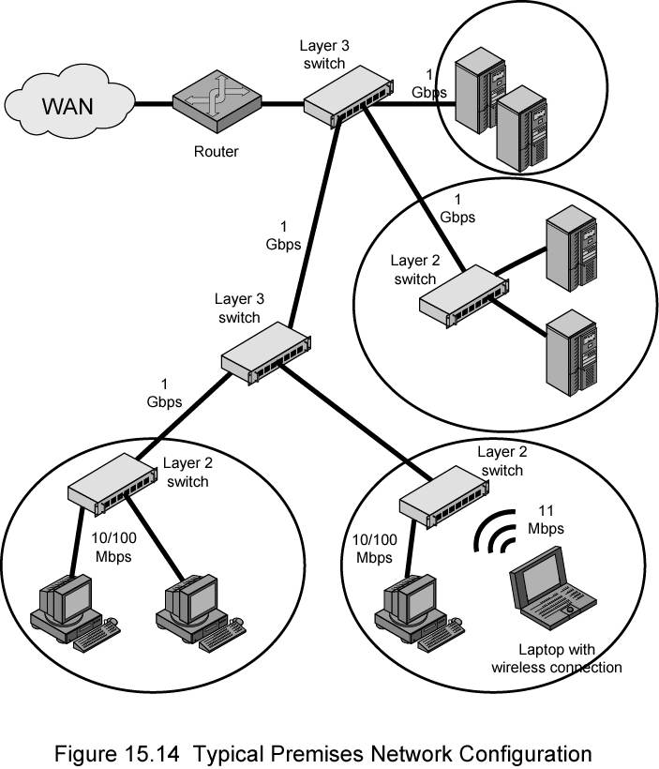
Typical Large LANs in an Organization
Circles in diagram identify separate LAN subnetworks
MAC broadcast frame limited to its subnetwork

Slide 135
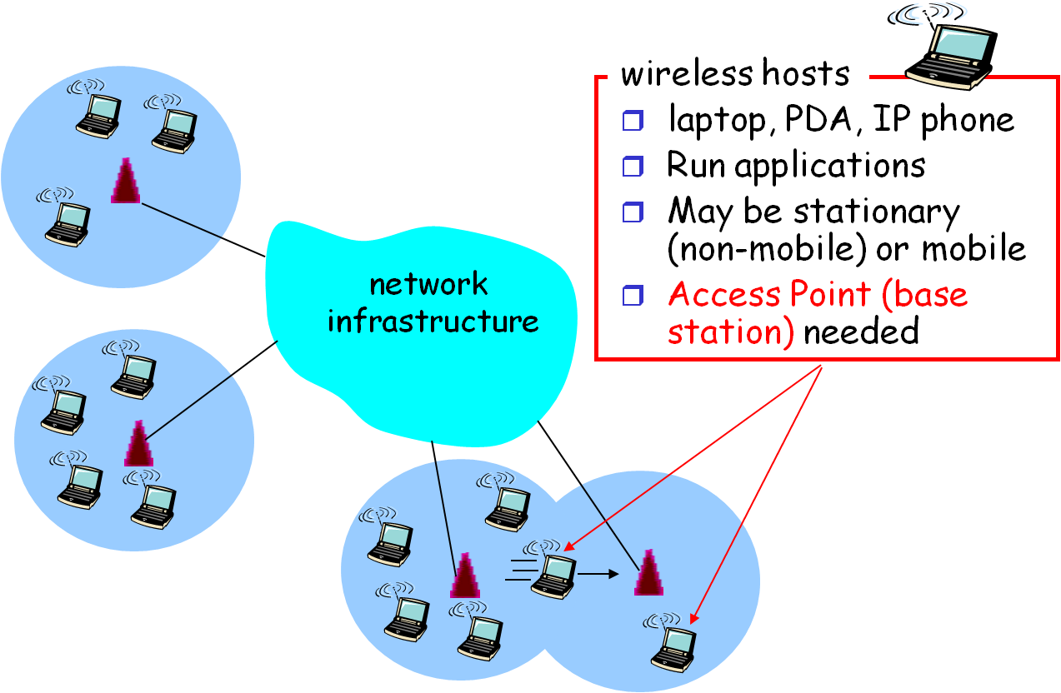
Wireless Networks

Slide 136
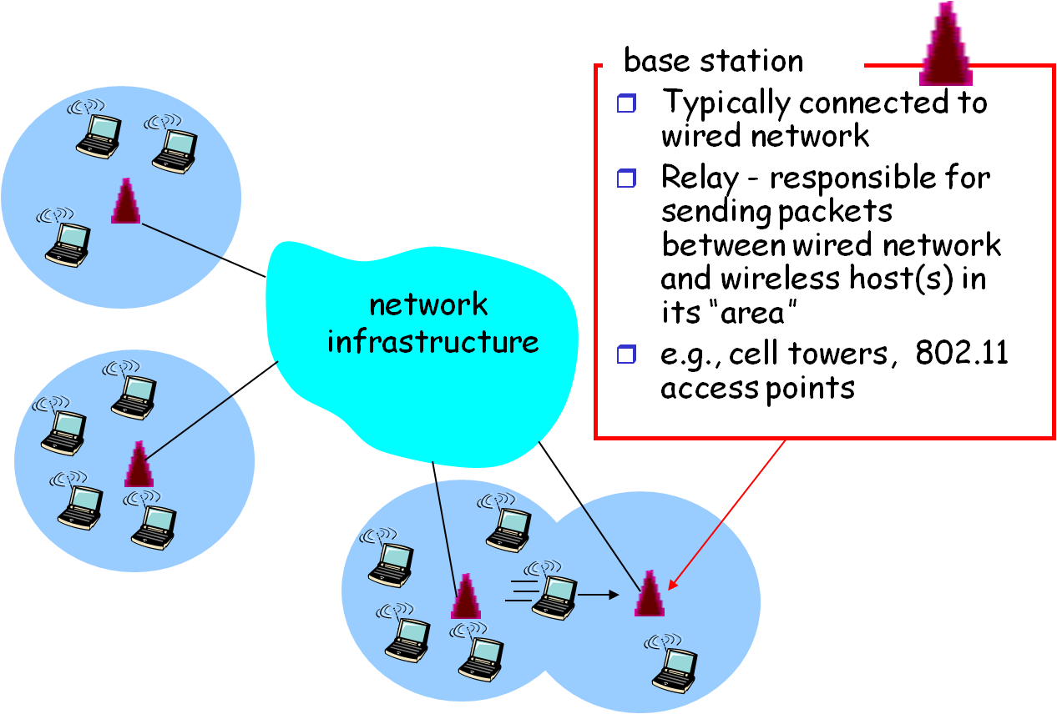
Elements of a Wireless Network

Slide 137
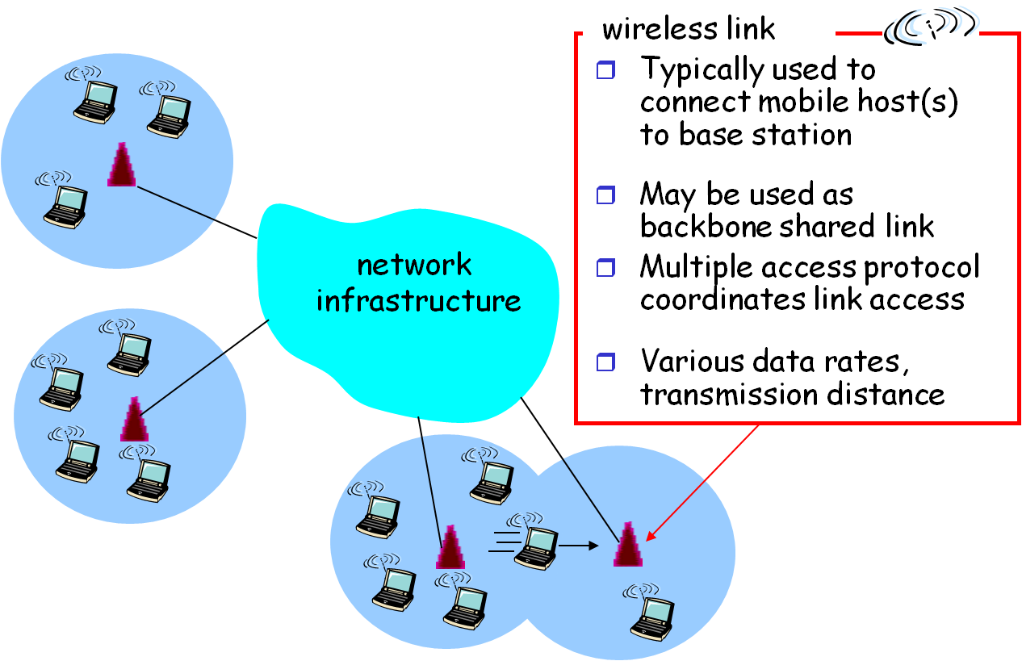
Elements of a Wireless Network

Slide 138
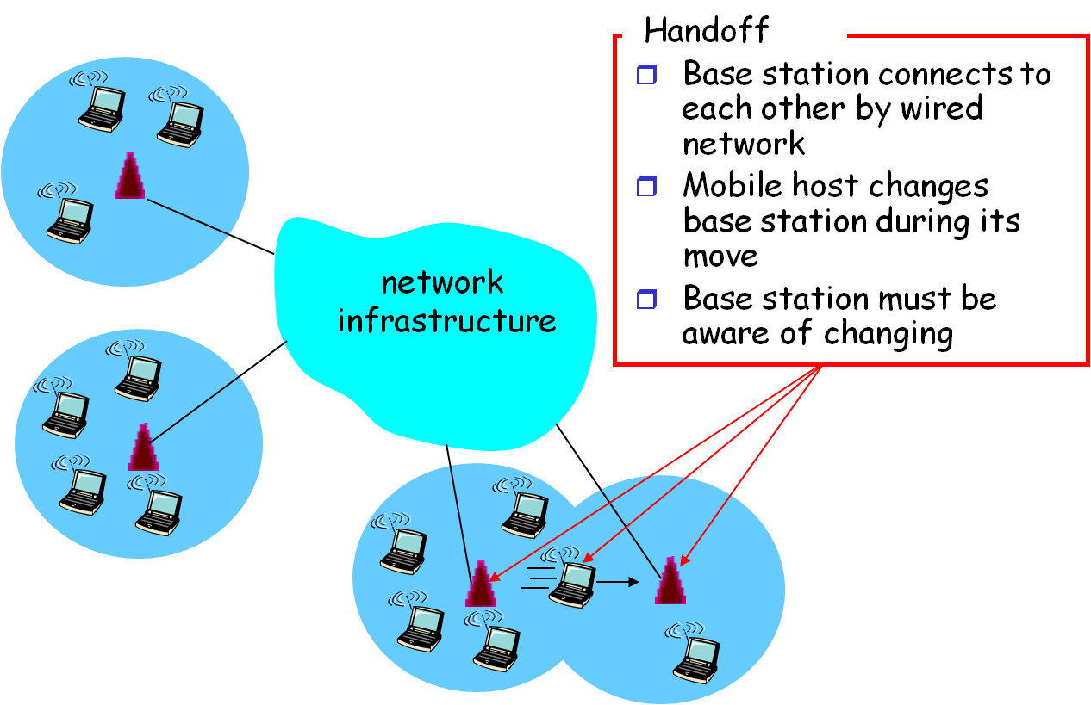
Elements of a Wireless Network

Slide 139
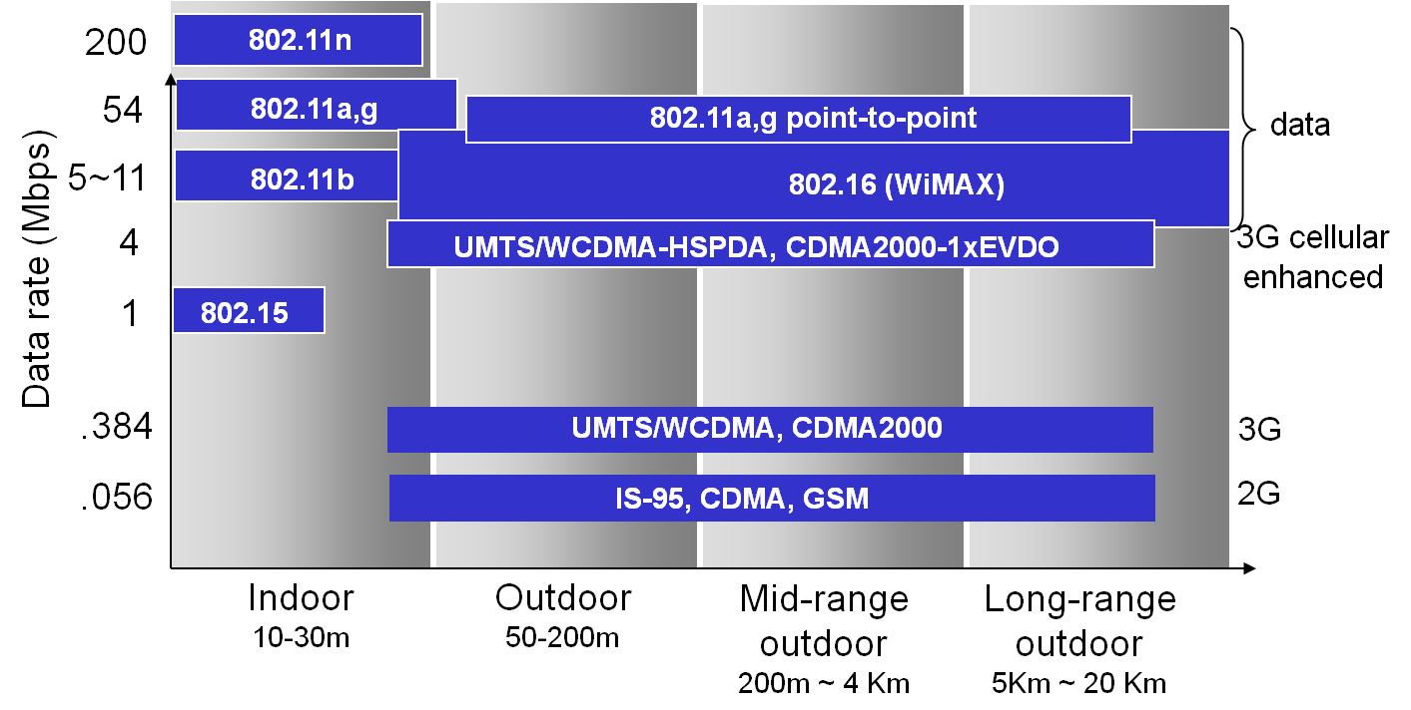
Various Wireless Link Standards

Slide 140
Wireless Link Characteristics
Different from wired link
Decreased signal strength:
Radio signal attenuates fast as it propagates through air
Multipath propagation:
Radio signal reflects off ground objects, arriving at destination by different times (self-interfering)
Interference from other sources:
Standard wireless network frequencies (e.g., 2.4 GHz) shared by other devices (e.g. phone, oven)
Robustness and security:
Interference prone and easily eavesdropped

Slide 141
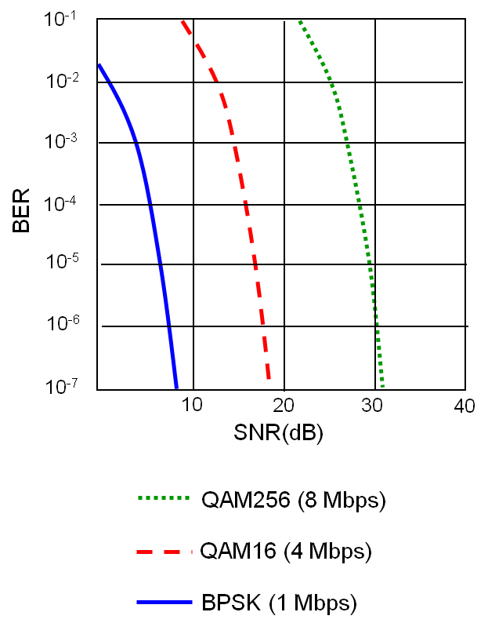
SNR vs. BER
SNR: signal-to-noise ratio
larger SNR → easier to extract signal from noise
BER: bit error rate
The lower the better
Transmission rate
Determined by physical layer (modulation technique)
Given physical layer
increase power -> increase SNR->decrease BER
But power is limited by battery life on mobile stations

Slide 142



Ad-hoc Networking
Peer-to-peer network, no base stations
Nodes organize themselves into a network: route among themselves

Slide 143
Standardized Wireless Networks
IEEE 802.11 WiFi
IEEE 802.16: WiMAX
IEEE 802.15: personal area network

Slide 144

IEEE 802.11 wireless LANs
A single-cell configuration

Slide 145

A Multi-Cell Configuration

Slide 146

IEEE 802.11 Architecture
Basic Service Set (BSS)
A single cell coordinated by one access point (base station)
Extended Service Set (ESS)
Multiple BSSs interconnected by Distribution System (DS)
DS can be a switch, wired network, or wireless network
An ESS appears as a single logical LAN
Portals (routers) provide access to Internet

Slide 147
Possible Communications
Server
Portal
Distribution System
Gateway to
the Internet
Portal
AP1
AP2
A1
BSS A
B1
A2
B2
BSS B

Slide 148
IEEE 802.11 Services
Service | Provider | Support
Authentication | Station | LAN access and security
Deauthentication | Station | LAN access and security
Privacy | Station | LAN access and security
MSDU send/receive | Station | MSDU delivery
Association | Distribution system | MSDU delivery
Disassociation | Distribution system | MSDU delivery
Reassociation | Distribution system | MSDU delivery
Distribution | Distribution system | MSDU delivery
Integration | Distribution system | MSDU delivery
Notes:
MAC service data units

Slide 149
Different Services
Distribution service
Exchange MAC frames that should traverse DS
Integration service
Enables transfer of data between station on 802.11 LAN and one on integrated 802.x LAN
Authentication/Deauthentication
Used to establish identity of stations to each other
Optional required before association
Privacy
Prevent messages being read by others (encryption)

Slide 150
Supporting Handoff
Association
Establishes initial association between station and AP
To make identity and address known
AP can communicate information to other APs within ESS
Reassociation
Transfer established association to another AP
Allows station to move from one BSS to another
Disassociation
From either station or AP that association is terminated
Given before station leaves ESS or shuts
i.e. handoff between ESS is unsupported

Slide 151


Scanning for Association
Passive Scanning:
Beacon frames sent from Aps
Association Request frame sent: H1 to selected AP
Association Response frame sent: AP to selected H1
Active Scanning:
Probe Request frame broadcast from H1
Probe response frame sent from Aps
Association Request frame sent: H1 to selected AP
Association Response frame sent: H1 to selected AP

Slide 152
Wireless Communication
Multiple wireless senders and receivers create additional problems (beyond multiple access)
A
B
C
C
A’s signal
strength
C’s signal
strength
B
A
Hidden terminal problem
B, A hear each other
B, C hear each other
A, C can not hear each other
A, C unaware of their interference at B
space
Signal fading problem
B, A hear each other
B, C hear each other
A, C can not hear each other interfering at B
Notes:
节能

Slide 153
4 Frame Exchange
To enhance wireless reliability, 4-frame exchange may be used
Source issues a Request to Send (RTS) frame to destination
Destination responds with Clear to Send (CTS)
After receiving CTS, source transmits data
Destination responds with ACK
Stations refrain from transmission to avoid collision
RTS alerts all stations within range of source that exchange is under way
CTS alerts all stations within range of destination
RTS/CTS exchange is a required function, but can be disabled

Slide 154
(a)
RTS
B
A requests to send
C
(b)
CTS
B
CTS
A
C
B announces A ok to send
(c)
B
Data Frame
A sends
C remains quiet
(d)
ACK
B
ACK
B sends ACK

Slide 155

IEEE 802.11 Protocol Architecture
Notes:
扩频技术：浪费频谱以抗干扰和侦听
Wi-Fi联盟：从802.11b开始，包括802.11g和802.11n

Slide 156
Media Access Control
Distributed wireless foundation MAC (DWFMAC)
Distributed access control mechanism
Optional centralized control on top
The lower sub-layer is distributed coordination function (DCF)
Contention algorithm to provide access to all traffic
CSMA/CA (collision avoidance)
The upper is point coordination function (PCF)
Centralized MAC algorithm, Contention free
Built on top of DCF
Notes:
分布式协同
点协同

Slide 157
Distributed Coordination Function
The DCF sub-layer uses CSMA/CA
Station senses medium before transmitting
Don’t collide with ongoing transmission by other station
DCF includes delays
Inter-frame space (IFS), station wait for IFS before transmitting
Accounts for priority scheme
No collision detection
Not practical on wireless network, since wireless signals fade quickly
Transmitting station cannot distinguish incoming weak signals from noise and effects of own transmission
ACK is used for success transmission

Slide 158
Inter-Frame Space
IFS rules for CSMA
1. Station with frame senses medium
If idle, wait to see if remains idle for 1 IFS. If so, may transmit immediately
If busy (either initially or becomes busy during IFS), monitor until current transmission is over
2. Once current transmission over, delay another IFS
If remains idle, backoff random time and again sense
If medium idle, station may transmit
During backoff time, if medium busy, backoff timer is halted and resumes when medium becomes idle
3. To ensure stability, binary exponential backoff used
Notes:
仅DIFS需要backoff

Slide 159

IEEE 802.11 Medium Access Control Logic
Only DIFS

Slide 160
3-level Priority
SIFS (short IFS)
Shortest IFS – highest priority
For all immediate responses
PIFS (point coordination function IFS)
Mid-length IFS
Used by the centralized controller in PCF scheme when issuing polls
DIFS (distributed coordination function IFS)
Longest IFS
Used for other asynchronous frames contending for access

Slide 161
SIFS Use (1)
Acknowledgment (ACK)
Station responds with ACK after waiting SIFS gap
Delivery of multiple frame LLC PDU
Station with multi-frame LLC PDU to transmit sends out 1st MAC frame using normal IFS
Each subsequent frames sent after SIFS
Poll response
Response frame after poll
Clear to Send (CTS)
Station can ensure data frame will get through by issuing RTS with normal IFS
Destination station should respond with CTS using SIFS if ready to receive
Notes:
SIFS必须：需要信号传输（衰减）完毕

Slide 162
PIFS and DIFS
PIFS used by centralized controller
Issuing polls
Takes precedence over normal contention traffic
Frames using SIFS have precedence over PCF poll
DIFS used for all ordinary asynchronous traffic
Notes:
IFS: Inter-Frame Space

Slide 163

IEEE 802.11 MAC Timing – DCF
Notes:
DCF – distributed coordination function

Slide 164
Transmission of MPDU without RTS/CTS
DIFS
Data
Source
SIFS
ACK
Destination
DIFS
Other
NAV (Network Allocation Vector)
Wait for Reattempt Time
Defer Access
Notes:
NAV: Source stations informs other stations of transmission time (in υsec) for an MPDU (a field in it)
节电：不用再监听信道

Slide 165
Transmission of MPDU with RTS/CTS
DIFS
RTS
Data
Source
SIFS
SIFS
SIFS
CTS
Ack
Destination
DIFS
NAV (RTS)
Other
NAV (CTS)
NAV (Data)
Defer access

Slide 166
Point Coordination Function (PCF)
Polling by centralized polling master (point coordinator)
Uses PIFS (<DIFS) when issuing polls
Can seize medium and lock out all asynchronous traffic while it issues polls and receives responses
Wireless network configured so number of stations with time-sensitive traffic are controlled by point coordinator
Point coordinator polls in round-robin to stations configured for polling
When poll issued, polled station may respond using SIFS
If point coordinator receives response, it issues another poll using PIFS
If no response during expected turnaround time, coordinator issues another poll
Repeat until current round ended
Notes:
2μ+SIFS

Slide 167
Super-frame
Super-frame defined by PCF
During first part of super-frame interval, point coordinator polls round-robin to all polling stations
Remainder of super-frame allows contention period for asynchronous access
At beginning of super-frame, point coordinator creates a contention-free period
Time varies because of variable frame size issued by responding stations
Rest of super-frame available for contention-based access
At end of super-frame interval, point coordinator contends for access using PIFS
By beacon frame, results in super-frame period for next cycle
Notes:
尽量保证“实时”

Slide 168
IEEE 802.11 MAC Timing – PCF

Slide 169
PCF Frame Transfer
TBTT
Super frame
PIFS
SIFS
PIFS
SIFS
PIFS
Contention period
B
D1 + Poll
D2+Ack+Poll
CF End
U1 + ACK
U2 + ACK
PIFS
Reset NAV
NAV
CF_Max_duration
D1, D2 = frame sent by point coordinator
U1, U2 = frame sent by polled station
TBTT = target beacon transmission time
B = beacon frame
Notes:
Network Allocation Vector
beacon：灯塔，帧里标识TBTT

Slide 170
IEEE 802.1 MAC Frames
Management frames
Control frames
Data frames

Slide 171
Management Frames
Manage communications between stations and APs
Station association & disassociation with AP
Authentication & deauthentication
Timing & synchronization

Slide 172
Control Frames
Power Save-Poll (PS-Poll)
Sent by any station to AP
Request AP transmission frame buffered for this station while station in power-saving mode
Request to Send (RTS)
Clear to Send (CTS)
Acknowledgment (ACK)
Contention-Free-End (CF-End)
Announces end of contention-free period (PCF)
CF-End + CF-Ack:
Acknowledges CF-End
Releases stations from associated restrictions
Notes:
从节电状态恢复

Slide 173
Data Frames – Data Carrying
8 data frame subtypes, in two groups
First 4 carry upper-level data from source station to destination station
Data
Pure data frame
Data + CF-Ack
Sent during contention-free period
Carries data and acknowledges previously received data
Data + CF-Poll
Used by point coordinator to deliver data
Also to request station send data frame it may have buffered
Data + CF-Ack + CF-Poll
Combines Data + CF-Ack and Data + CF-Poll
Notes:
CF-ACK + CF-Poll：还有时间再发送数据

Slide 174
Data Frames – No Data Carrying
Last 4 data frames do not carry user data
Null Function
Carries no data, polls, or acknowledgments
Carries power management bit in frame control field to AP
Indicates station is changing to low-power state
Other 3 frames
CF-Ack, CF-Poll, CF-Ack + CF-Poll
Same as corresponding frame in preceding list but without data

Slide 175
Frame Control Fields (1)
MAC header (bytes)
2
2
6
6
6
2
6
0-2312
4
Frame
Control
Duration/
ID
Address
1
Address
2
Address
3
Sequence
control
Address
4
Frame
body
CRC
2
2
4
1
1
1
1
1
1
1
1
Protocol
version
Type
Subtype
To
DS
From
DS
More
frag
Retry
Pwr
mgt
More
data
WEP
Rsvd
Protocol version = 0
Type: Management (00), Control (01), Data (10)
Subtype within frame type, e.g.
Type=00, subtype=association; Type=01, subtype=ACK
MoreFrag=1 if another fragment of MSDU to follow

Slide 176
Frame Control Fields (2)
2
2
6
6
6
2
6
0-2312
4
Frame
Control
Duration/
ID
Address
1
Address
2
Address
3
Sequence
control
Address
4
Frame
body
CRC
2
2
4
1
1
1
1
1
1
1
1
Protocol
version
Type
Subtype
To
DS
From
DS
More
frag
Retry
Pwr
mgt
More
data
WEP
Rsvd
To
DS
From
DS
Address
1
Address
2
Address
3
Address
4
Meaning
0
0
Destination
address
Source
address
BSS ID
N/A
Data frame from station to station within a BSS
0
1
Destination
address
BSS ID
Source
address
N/A
Data frame exiting the DS
1
0
BSS ID
Source
address
Destination
address
N/A
Data frame destined for the DS
1
1
Receiver
address
Transmitter
address
Destination
address
Source
address
WDS frame being distributed from AP to AP
To DS = 1 if frame goes to DS; From DS = 1 if frame exiting DS
Notes:
WDS: Wireless DS?

Slide 177
Frame Control Fields (3)
MAC header (bytes)
2
2
6
6
6
2
6
0-2312
4
Frame
Control
Duration/
ID
Address
1
Address
2
Address
3
Sequence
control
Address
4
Frame
body
CRC
2
2
4
1
1
1
1
1
1
1
1
Protocol
version
Type
Subtype
To
DS
From
DS
More
frag
Retry
Pwr
mgt
More
data
WEP
Rsvd
Retry =1 if mgmt/control frame is a retransmission
Power Management used to put station in/out of sleep mode
More Data =1 to tell station in power-save mode more data buffered for it at AP
WEP =1 if frame body encrypted
Notes:
WEP: Wired Equivalent Privacy

Slide 178
Other MAC Frame Fields (1)
Duration/Connection ID
If used as duration, indicates time (in μs) channel will be allocated for successful transmission of MAC frame
In some management frames, contains association or connection identifier
Addresses
Number and meaning of address fields depend on context
Types include source, destination, transmitting station, and receiving station

Slide 179
Other MAC Frame Fields (2)
Sequence Control
4-bit fragment number subfield
For fragmentation and reassembly
12-bit sequence number
Number frames between given transmitter and receiver
Frame Body
MSDU, or a fragment of MSDU
LLC PDU or MAC control information
Frame Check Sequence
32-bit cyclic redundancy check

Slide 180

Integrate 802.11 and 802.3 nets

Slide 181
802.11 Physical Layer
1997
IEEE 802.11, includes MAC layer and 3 physical layer specifications
Two in 2.4-GHz band and one infrared
All operating at 1 and 2 Mbps
1999
IEEE 802.11a, 5-GHz band up to 54 Mbps
IEEE 802.11b, 2.4-GHz band at 5.5 and 11 Mbps
2003 and later
IEEE 802.11g, extends IEEE 802.11b, up to 54 Mbps
IEEE 802.11n, improves 802.11a and 802.11g using multiple antennae (MIMO, multiple-input multiple-output)
Notes:
IEEE 802.11n, 2009

Slide 182

802.15: Personal Area Network
802.15
Evolved from Bluetooth specification
2.4 GHz radio band
<10m diameter, Up to 721 kbps
Functions
Replacement for cables (mouse, keyboard, headphones)
Master/Slaves:
Slaves request permission to send (to master)
Master grants requests

Slide 183


802.16: WiMAX
Worldwide Interoperability for Microwave Access
Like 802.11 & cellular: base station model
Transmissions to/from base station by hosts with omnidirectional antenna
Base station-to-base station backhaul with point-to-point antenna
Unlike 802.11
Range ~ 6 miles (“city area”)
~14 Mbps

Slide 184

802.16: WiMAX
Channel partitioning
The subscriber station (SS) cannot transmit data until allocated a channel by the Base Station (BS)
Transmission frame
Down-link subframe: base station to node
Uplink subframe: node to base station

Slide 185
Network Performance
Media Utilization
Time used for frame transmission vs. time the shared media is occupied
Relative Propagation Time

Slide 186
Different Networks
Contention free
Point-to-Point Link
Ring LAN
Random access
ALOHA
CSMA/CD

Slide 187
Point-to-Point Link with No ACK

Slide 188
Max Utilization for Point-to-Point Link
Parameters and assumptions
1: normalized frame transmission time
a: end to end propagation delay
N: number of stations
Each station has frames to transmit
Total frame time: 1+a
Max Utilization:

Slide 189
Ring LAN

Slide 190
Max Utilization for Ring LAN
Define
T₁ : Average time to transmit a frame, i.e. T₁ = 1
T₂ : Average time to pass the token after frame transmission
Max Utilization: U = T₁/(T₁+T₂)
2 cases
Case 1: a<1 (frame longer than ring)
T₂ = time to pass token to the next station = a/N
Case 2: a>1 (frame shorter than ring)
T₂ = sender wait for frame returns after transmission = a–1+a/N
Notes:
Try calculate U for FDDI

Slide 191
Slotted ALOHA
Suppose:
N nodes with many frames to send, each transmits in slot with probability p
Probability of successful transmission
One node has success in a slot
Any node has a success
Maximize value of A

Slide 192
Slotted ALOHA
Utilization if a slot is successfully used
Since A is the rate of success slot

Slide 193

Pure ALOHA
Simpler but collision probability increases
Frame sent at t₀ collides with other frames sent in [t₀−1, t₀+1]

Slide 194
Pure ALOHA
Suppose:
N nodes with many frames to send, each transmits in a slot with probability p
Probability of successful transmission

Slide 195
CSMA/CD
Contention slots end in a collision
Contention interval is a sequence of contention slots
Length of a slot in contention interval is 2a
Suppose the probability that a station attempts to transmit in a slot is p

Slide 196
Max Utilization for CSMA/CD (1)
Let A be the probability that some station can successfully transmit in a slot, then:
In above formula, A is maximized when p=1/N, thus:
Notes:
冲突或空闲

Slide 197
Max Utilization for CSMA/CD (2)
Probability of a contention interval with j slots
The expected number of slots in a contention interval is then calculated as:

Slide 198
Max Utilization for CSMA/CD (3)
Maximum Utilization
Let N→∞, A = (1–1/N)^{N–1} = 1/e (e=2.718)
Notes:
Simulation result for CSMA/CD: U=1/(1+5a)

Slide 199
Chapter Goals
Understand principles behind direct link networks
Error detection and flow control
Addressing and multiple access
Data link layer protocols
Layer-2 switches
Performance analysis (optional)
Instantiation of direct link networks
Ethernet
Wireless LAN (WiFi)

